Slide 1
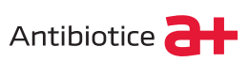
Therapeutic deep eutectic systems
11.07.2024
Marin sebastian
Pg.1

Slide 2

Therapeutic deep eutectic system in maximising drug delivery
Pharmaceutical products
Intravenous Infusion
Implantable systems
Intramuscular injection
Subcutaneous delivery
Ocular drug delivery
When and Why ?
Pharmaceutical application
Poorly soluble API
Novel delivery systems
Impact on environment
Sustainability
Low toxicity profile
Low cost of production
Fine tunability
Biodegradability
API’s dissolution enhancement
Tuberculosis
Microbial infection
Amoebiasis
Wound healing
Hepatotoxicity
Cancer
Fortifying bioactive compounds
Some Fabrication Approaches
Electrospinning technique
Self-emulsification method
Supercritical fluid technique
Nanoprecipitation
Miscellaneous technique
2024
Pharmaceutical applications of therapeutic deep eutectic systems (THEDES) in maximising drug delivery, Javed et.al., Heliyon 10 (2024) e29783, https://doi.org/10.1016/j.heliyon.2024.e29783
Pg.5

Slide 3
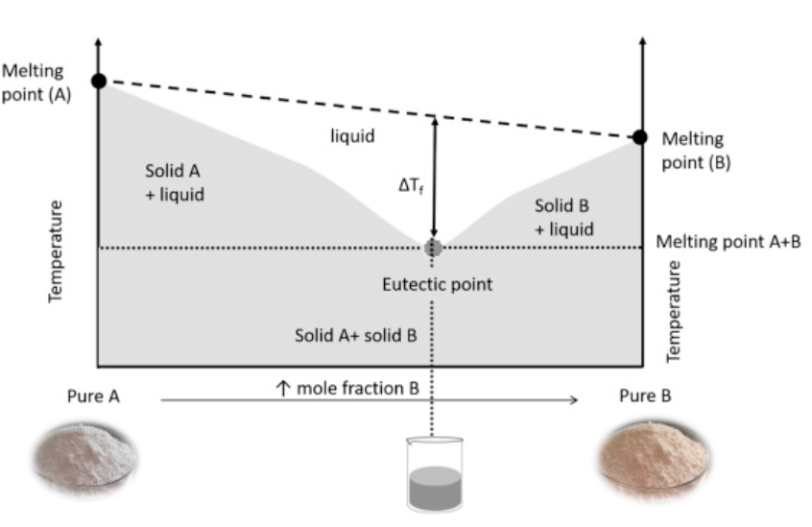
Therapeutic deep eutectic system (THEDES)
Made by mixing APIs with deep eutectic solvents (DES) in a definite molar ratio
Deep eutectic solvents: mixtures of two or more solid compounds which form a liquid phase at room temperature at a particular composition
Green solvents
        Cheap
        Easy to prepare
        Biodegradable
        Multi-use
Hydrogen bond – intermolecular interaction between components: H – Bond Donor, H – Bond Acceptor
Multiple hydrogen bonds stabilize the molecular network
DES examples:
        Choline chloride & urea
        Choline chloride & lactic acid
        Choline chlorine & glycerol
Improve the solubility of API
Enhance the permeability of API
Pharmaceutical applications of therapeutic deep eutectic systems (THEDES) in maximising drug delivery, April 17, 2024 DOI:https://doi.org/10.1016/j.heliyon.2024.e29783
S. Fourmentin, M. Gomes, E. Lichtfouse, Deep Eutectic Solvents for Medicine, Gas Solubilization and Extraction of Natural Substances, 2020.
Francisco Pena-Pereira, Inmaculada de la Calle, in Encyclopedia of Analytical Science (Third Edition), 2019
Pg.2

Slide 4
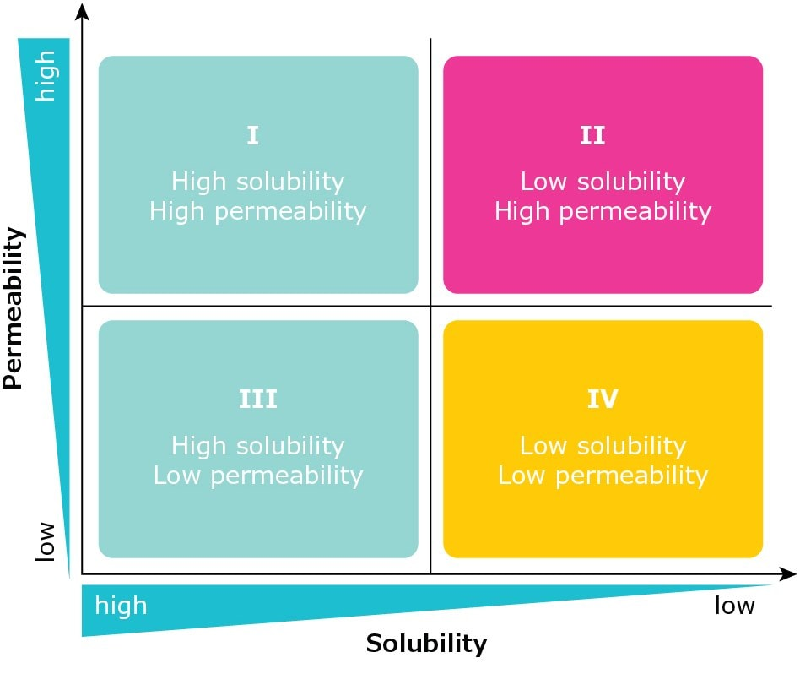
Ethambutol / L-arginine / Citric Acid THEDES system
anti-tuberculosis APIs delivery system
Adjust the dosage
Ethambutol / L-arginine / Citric Acid / Water
Class 1: High solubility, High Permeability
Research and Development Laboratory Studies
• Polarized Optical Microscopy - POM
• Differential Scanning Calorimetry - DSC
• Nuclear Magnetic Resonance - RMN
• Solubility and Permeability Studies
• In Vitro Cytotoxicity and IC50 Evaluation
Ethambutol:
Class 3: High solubility, Low Permeability
https://www.sigmaaldrich.com/deepweb/assets/sigmaaldrich/marketing/global/documents/635/358/improving-api-solubility-wp12169en-mk.pdf
2019
Properties of Therapeutic Deep Eutectic Solvents of L-Arginine and Ethambutol for Tuberculosis Treatment, Filipa Santos et.al., Molecules 2019, 24, 55; doi:10.3390/molecules24010055
Pg.3

Slide 5
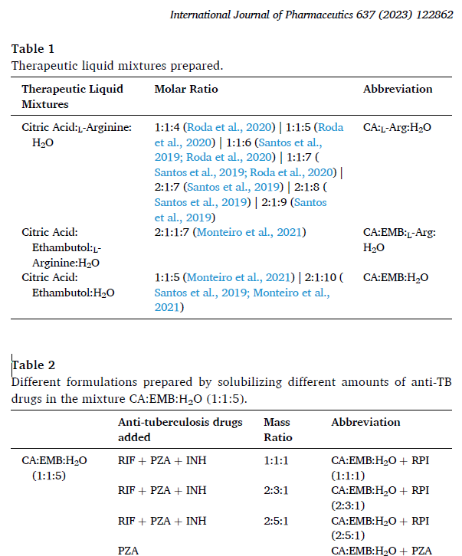
More THEDES as a carrier systems
Ethambutol / L-arginine / Citric Acid
Research & Development Methods
Polarized Optical Microscopy
NMR
Isoniazid ( INH )
FT-IR - ATR
Rifampicin ( RIF )
Cell culture & viability assays
Pyrazinamide ( PZA )
Permeation studies
Antimicrobial activity
Statistical analysis
Stability studies
2023
Insights into therapeutic liquid mixtures and formulations towards tuberculosis therapy, Santos et.al., International Journal of Pharmaceutics 637 (2023) 122862, https://doi.org/10.1016/j.ijpharm.2023.122862
Pg.4

Slide 6
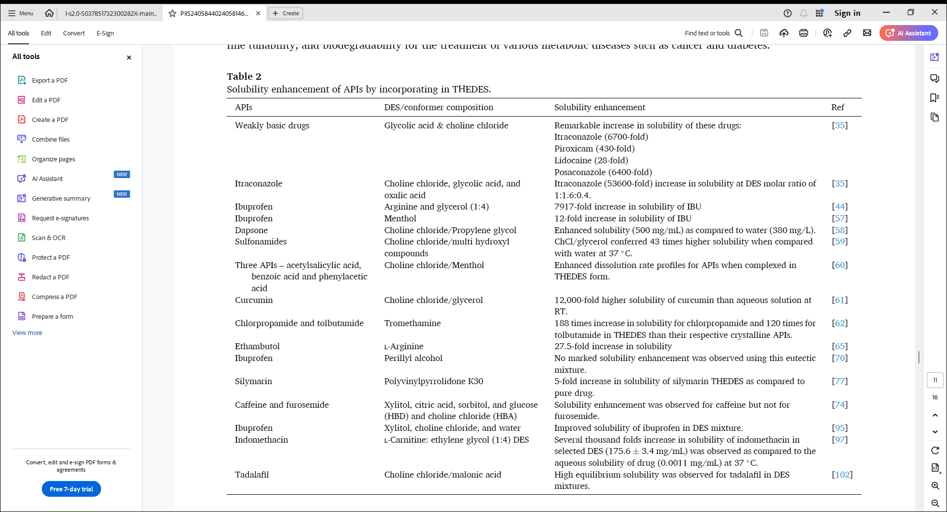
Solubility enhancement by the THEDES technique
2024
Pharmaceutical applications of therapeutic deep eutectic systems (THEDES) in maximising drug delivery, Javed et.al., Heliyon 10 (2024) e29783, https://doi.org/10.1016/j.heliyon.2024.e29783
Pg.6

Slide 7
Solubility enhancement by the THEDES technique
2024
Pharmaceutical applications of therapeutic deep eutectic systems (THEDES) in maximising drug delivery, Javed et.al., Heliyon 10 (2024) e29783, https://doi.org/10.1016/j.heliyon.2024.e29783
Pg.7

Slide 8

INOVA a+

