Slide 1
De la Empirism la High Performance Computing si Large Scale Data Science
int main()
{

Slide 2


Slide 3
Large Interconnected Sensor Array

Slide 4

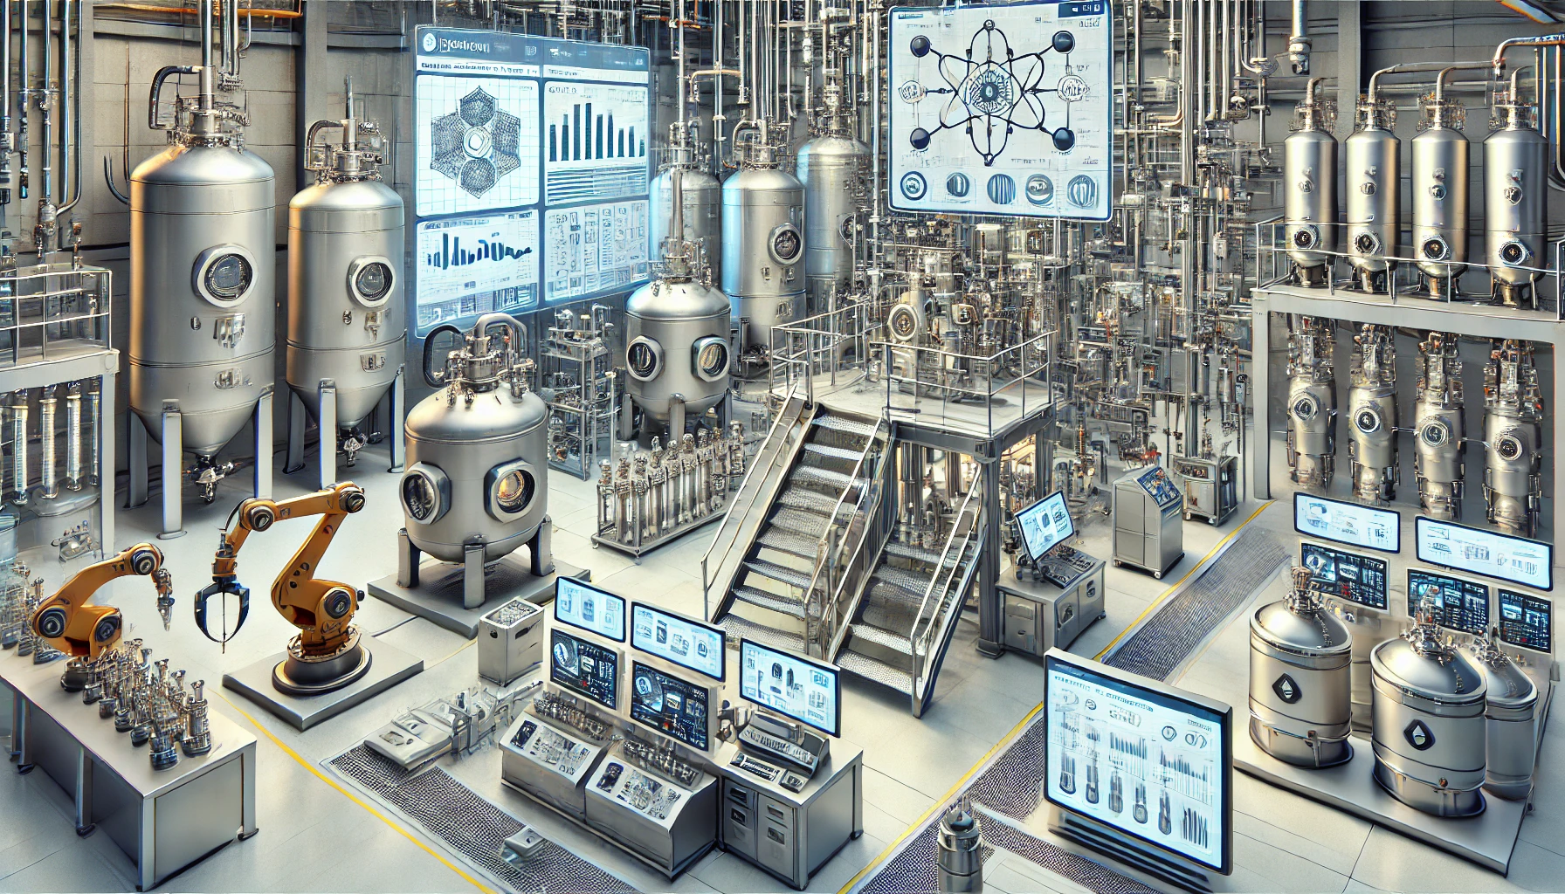

Slide 5
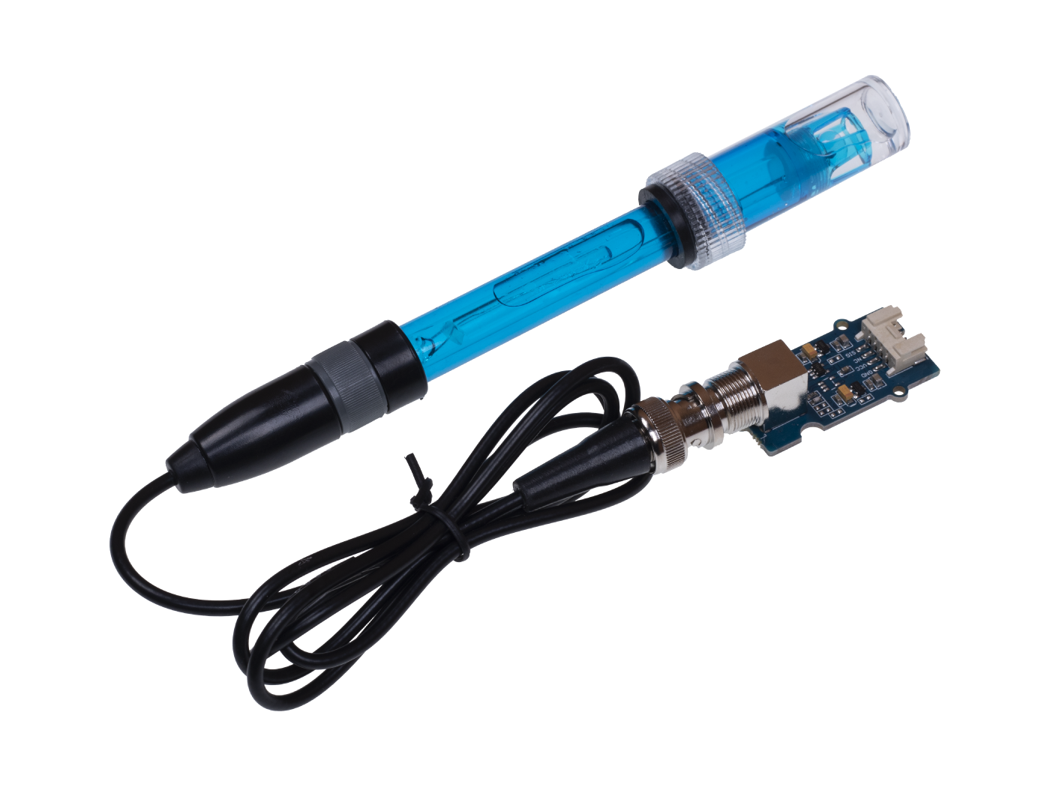
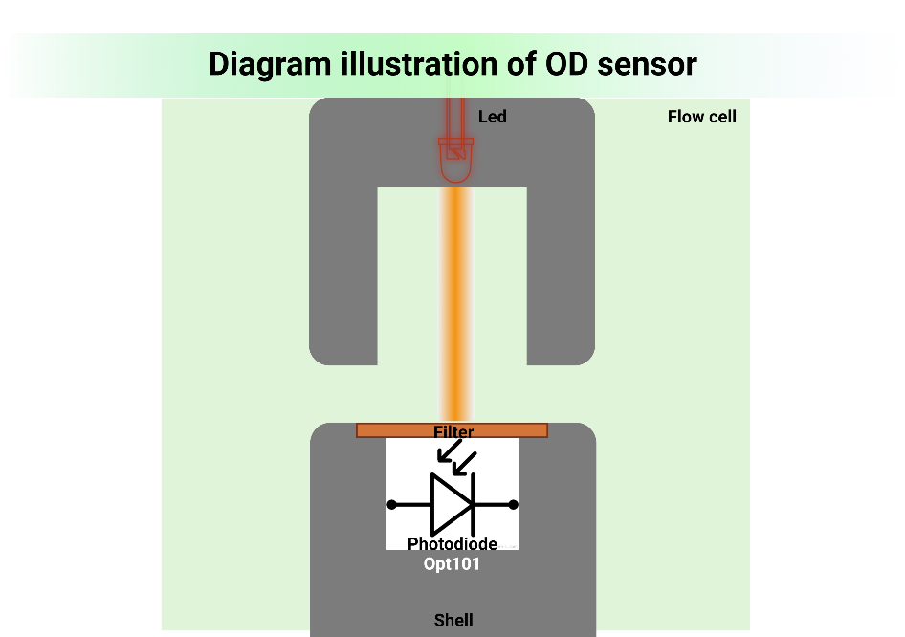
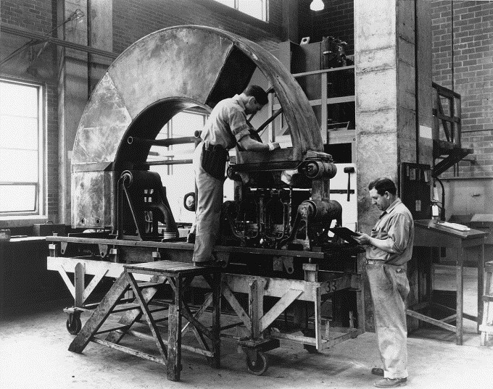

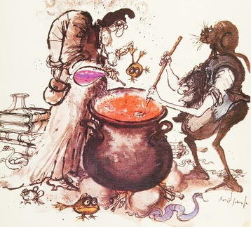

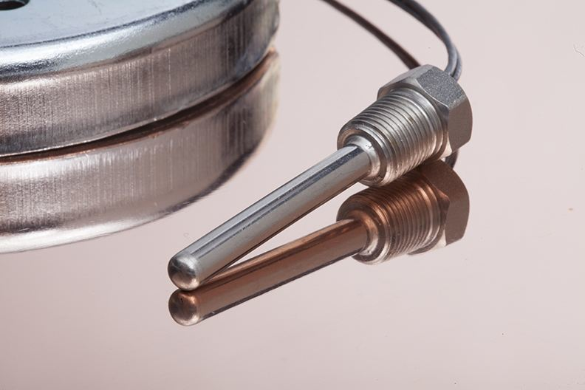
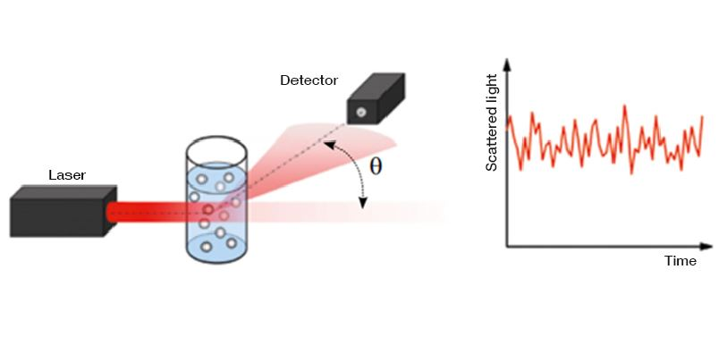
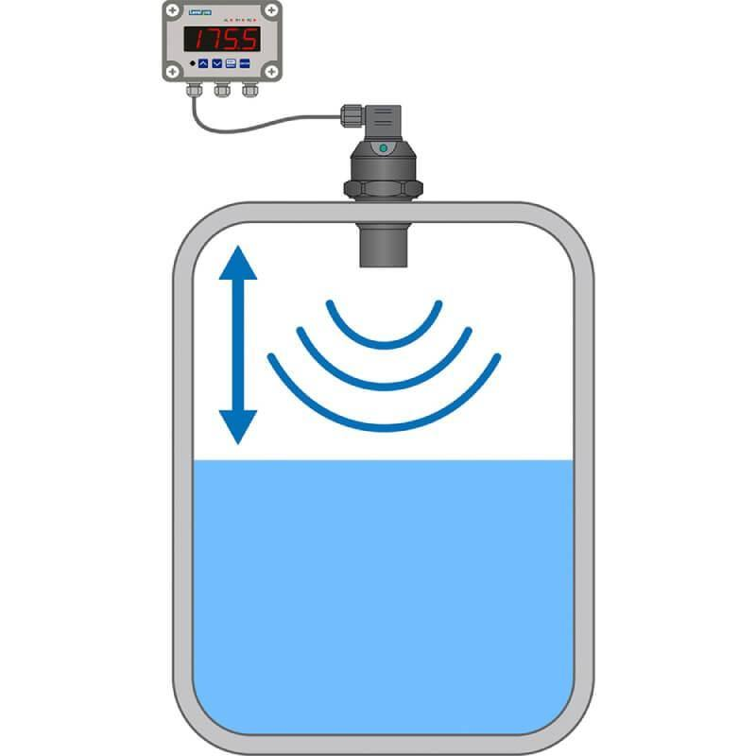
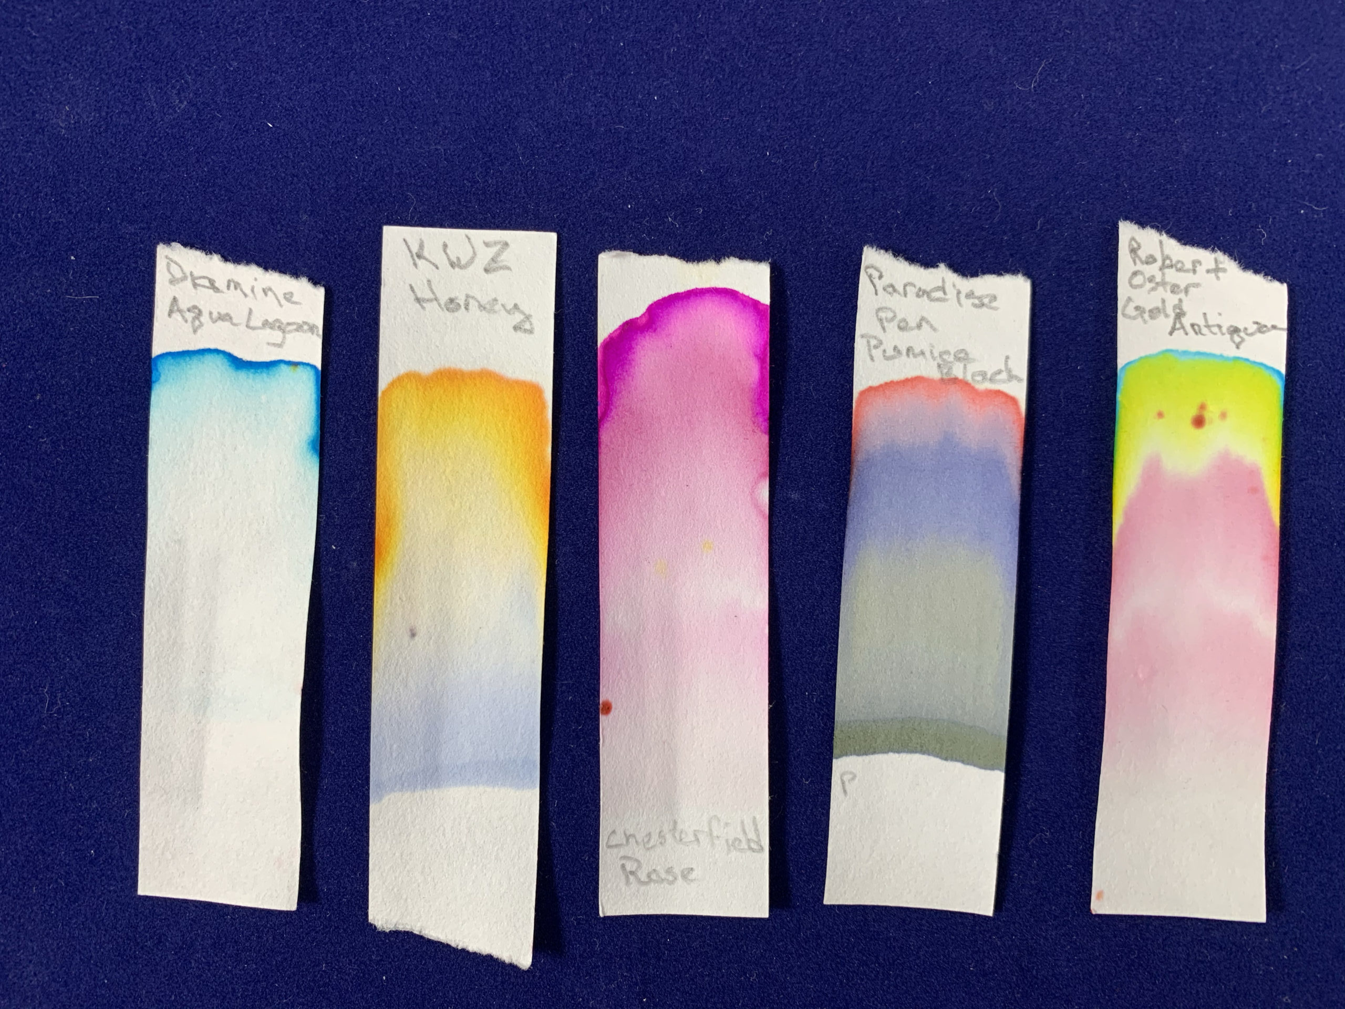
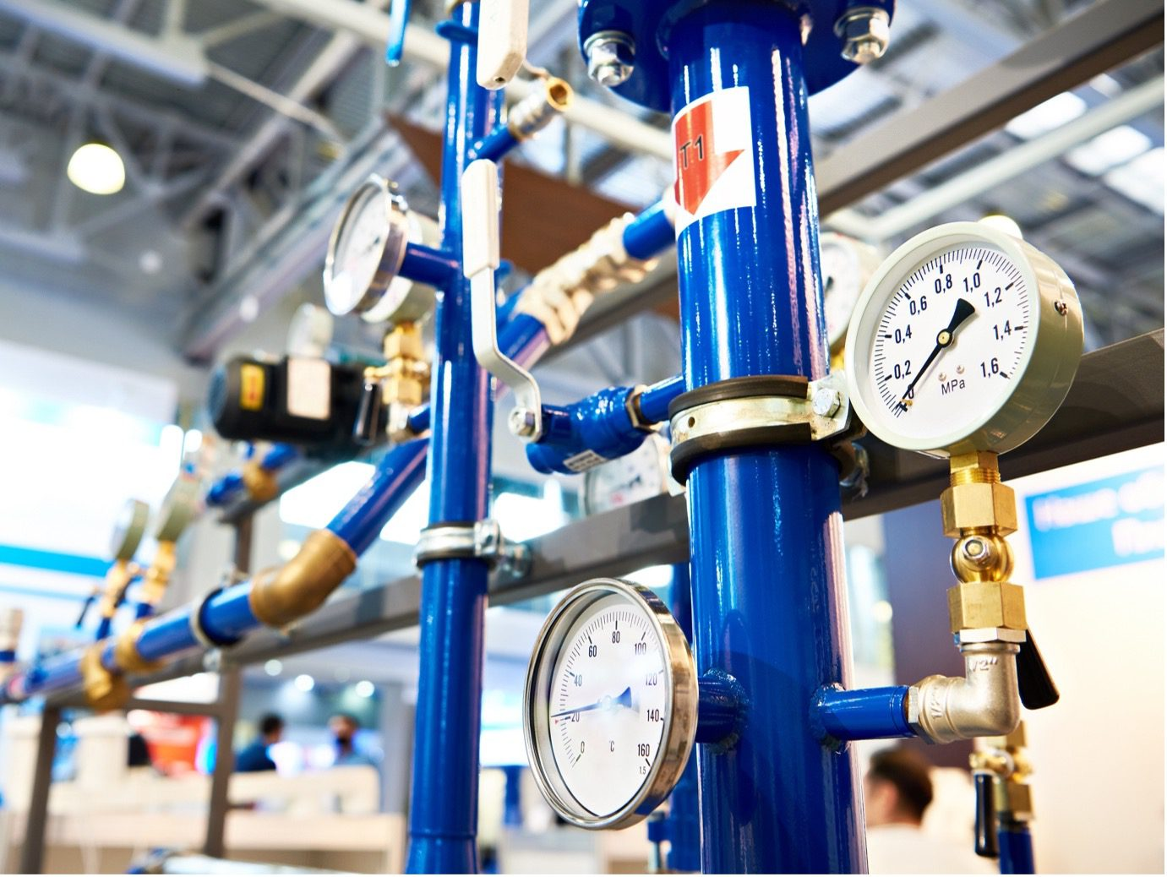
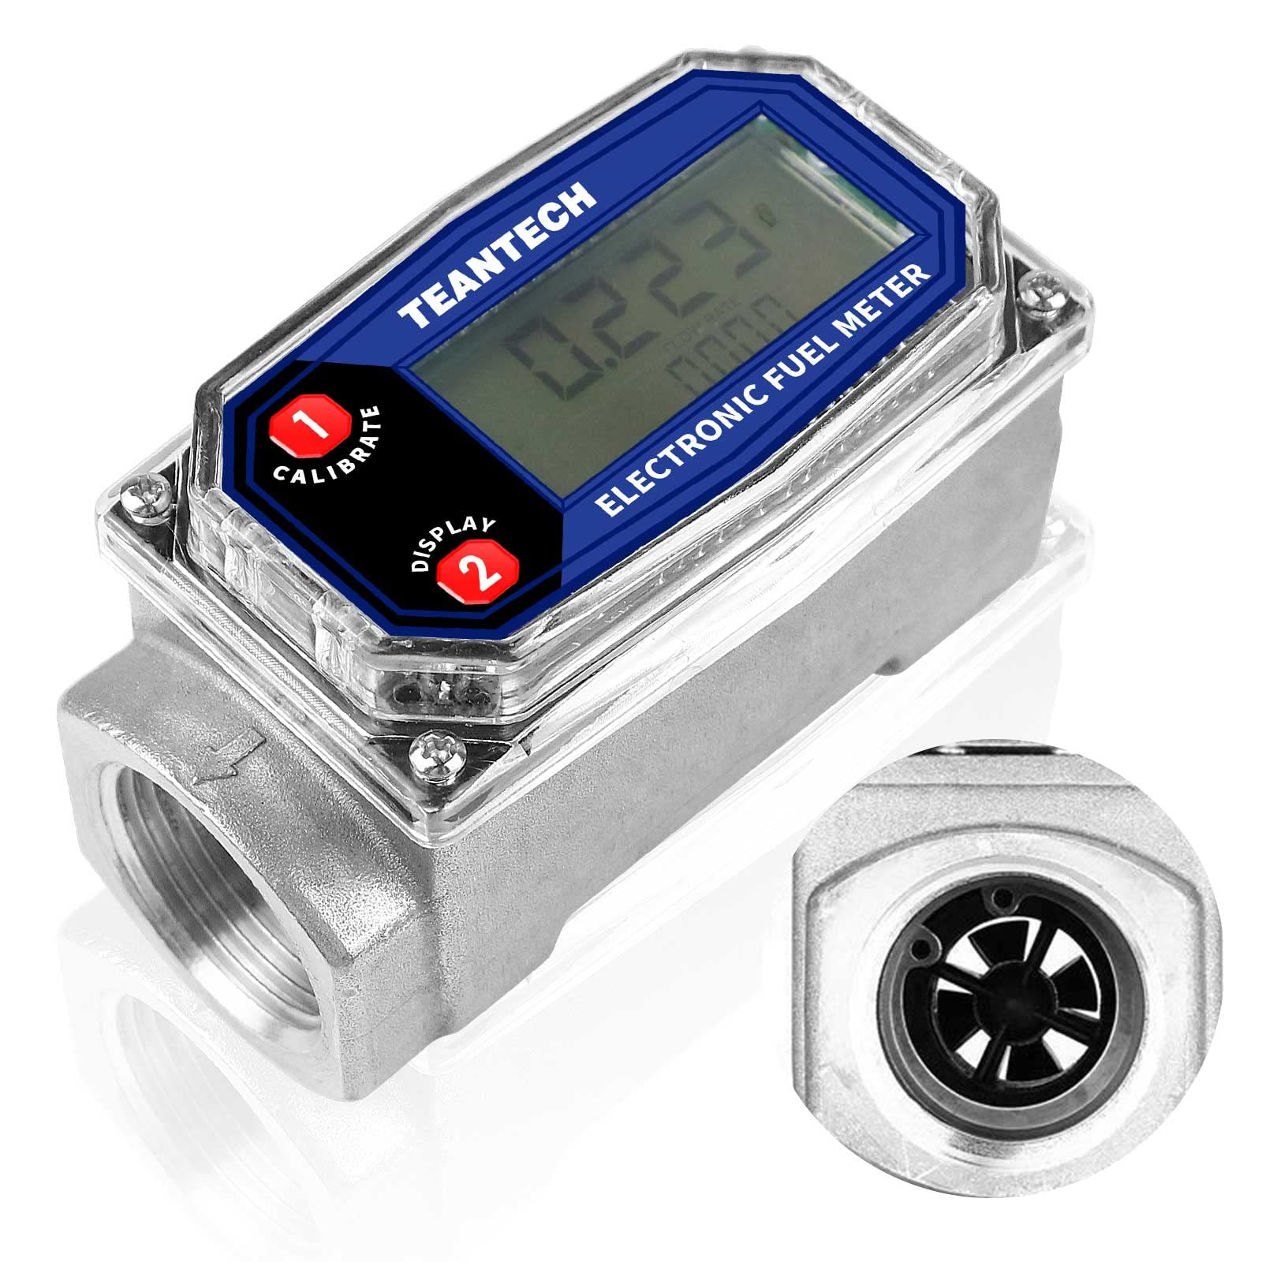

Slide 6
Concentration of API
Air content
Growth rate/death rate
Moisture content
Clean room status
Those, at least 345 problems that will appear because you (not you in the room), but you as a company decide to build a full - size manufacturing plant first before building a small - scale pilot for testing.
Byproduct concentration
Clogging
Temperature/ heat flux
Many more, but < 345 if you do the right thing
Physical processes
Process impurities development
Particle size/ droplet size
Content uniformity
Process impurities development
Energy consumption and recovery
Individual step throughput and sync. problems
Pressure /vacuum
Viscosity
Density
Particle size

Slide 7
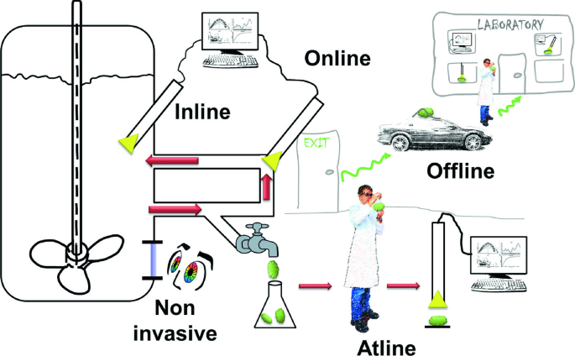

Slide 8

GAMMAS

Slide 9
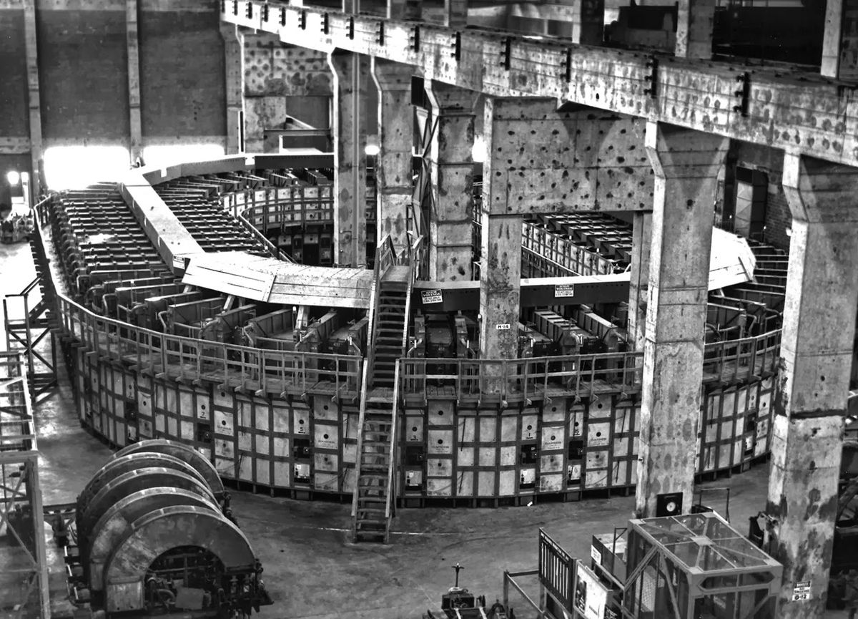


Gas Analyzer And Mass Spectrometry Automated System
$$\frac{m}{e}$$
$$\frac{B^{2}R^{2}}{2V}$$

Slide 10
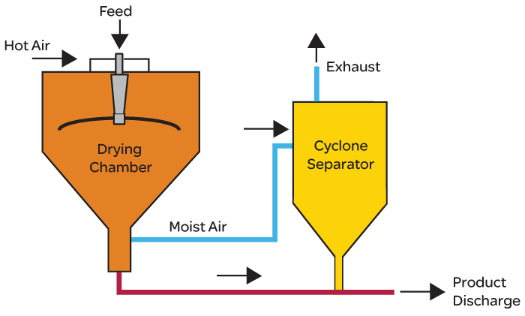
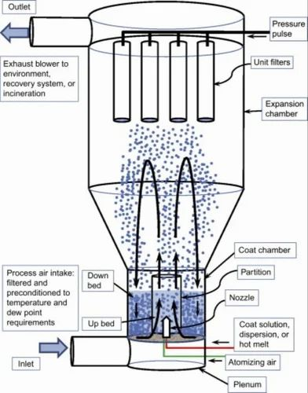
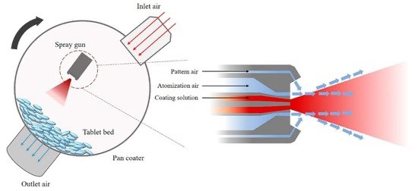
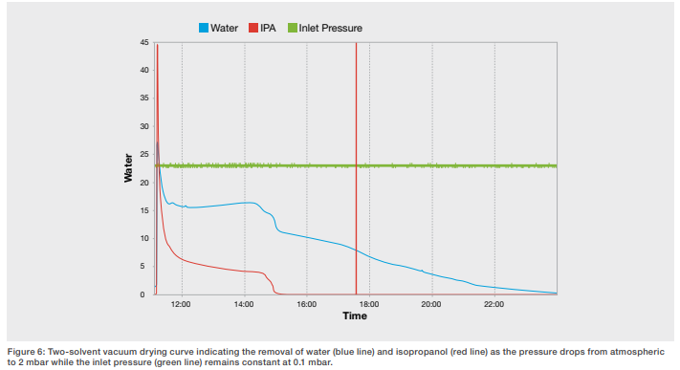
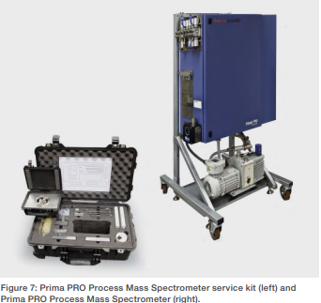
Prima pro Process Mass Spectrometer ThermoFisher Scientific – Analiza cantitativa → Concentratii solventi

Slide 11
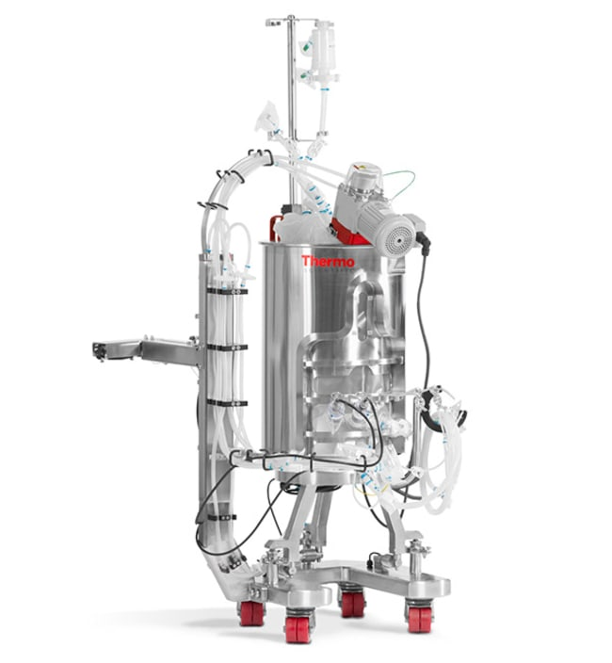
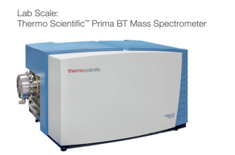
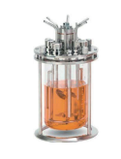
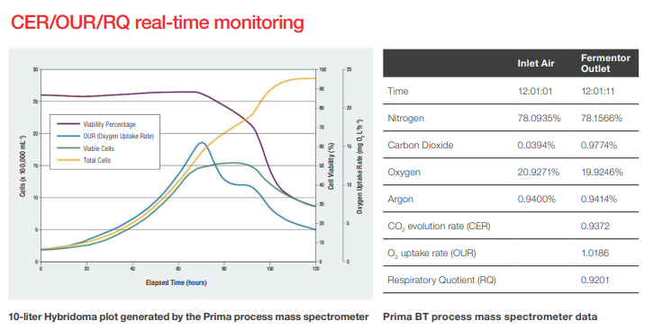
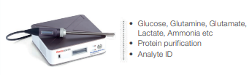
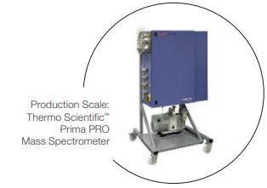

Slide 12

EMARSA

Slide 13
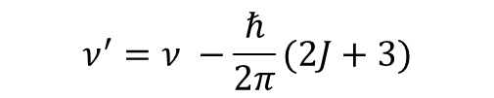
Electormagnetic Absorption – Reflection Sensor Array
$$ν^{′}=ν −\frac{ℏ}{2π}(2J+3)$$

Slide 14
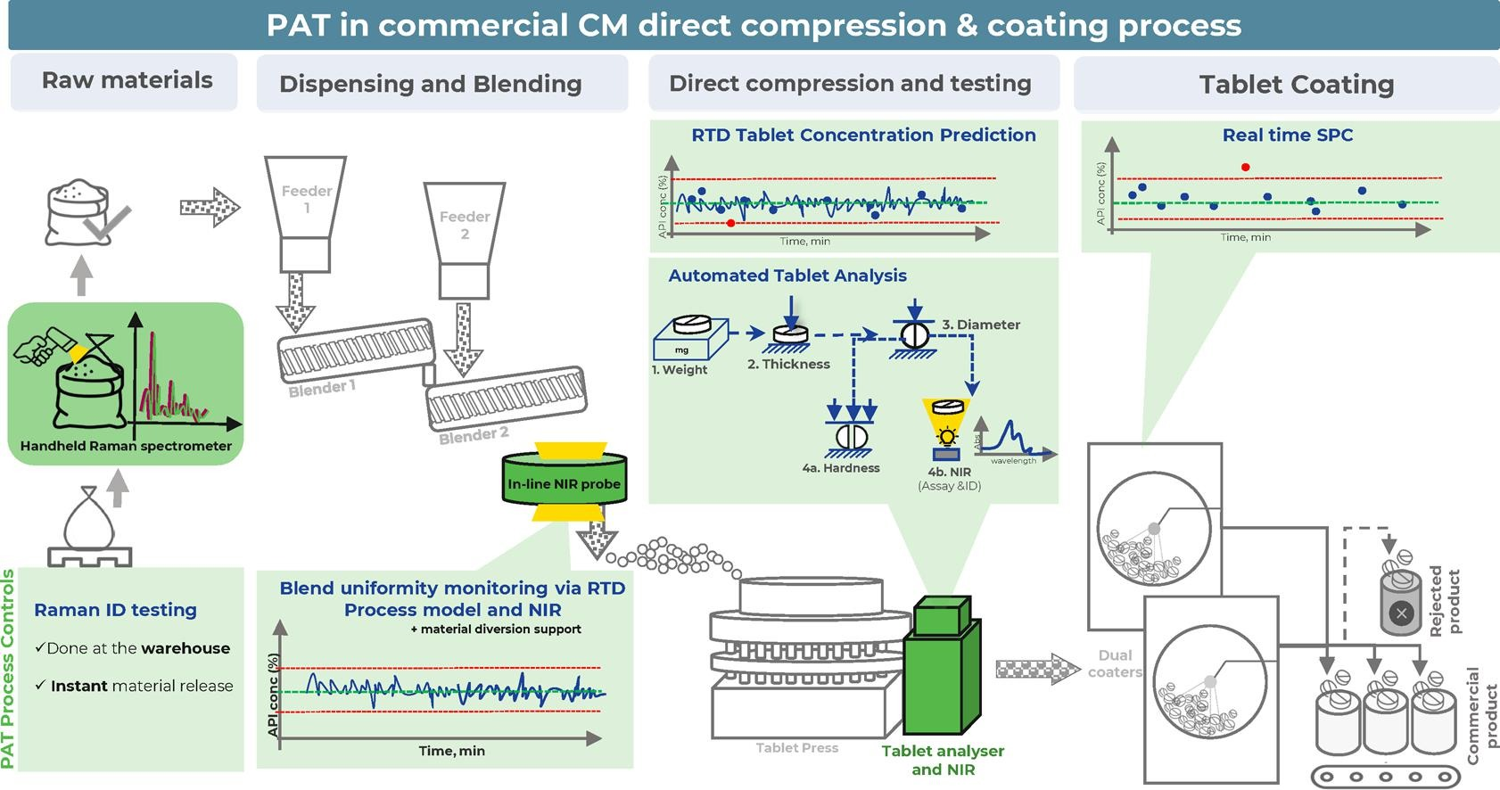
Residence time distribution
Statistical process control

Slide 15
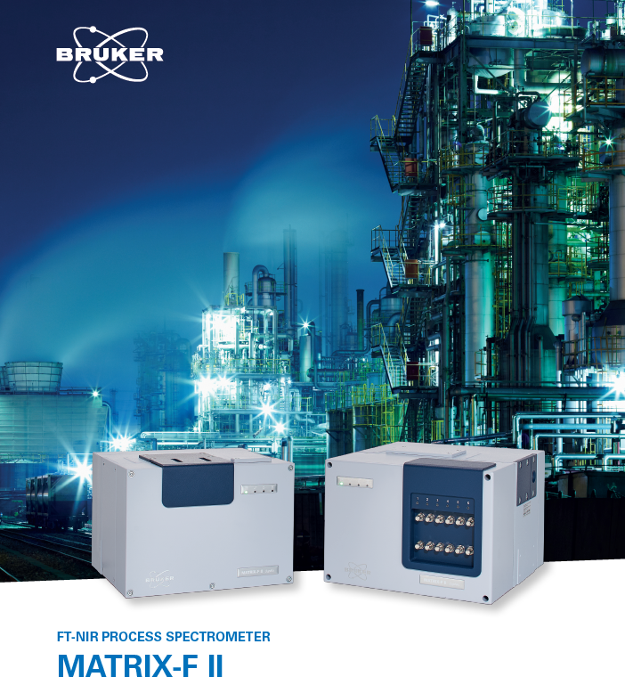
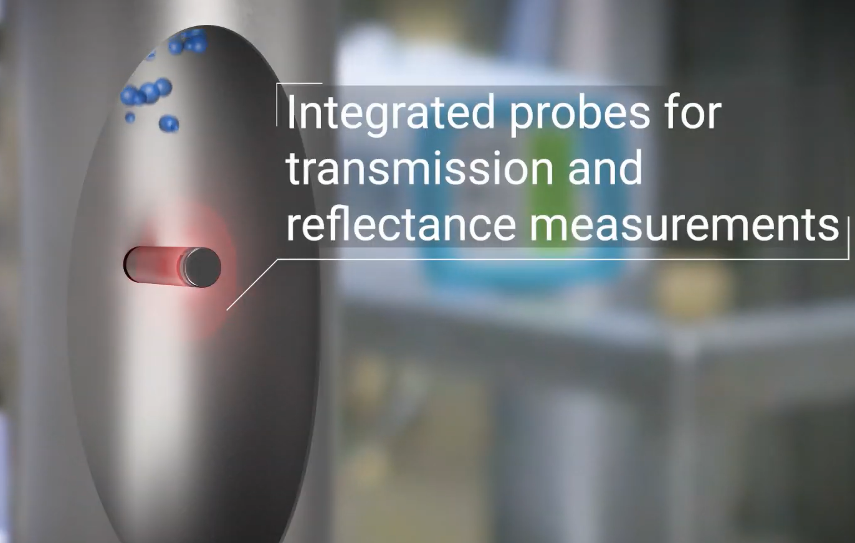
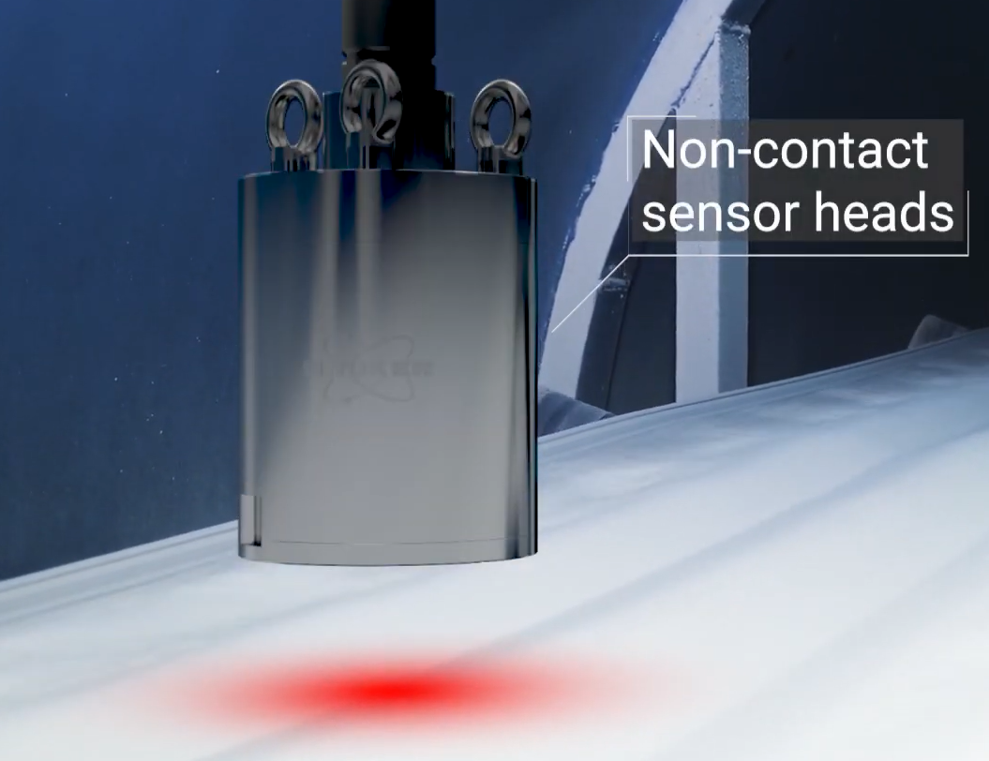

Slide 16
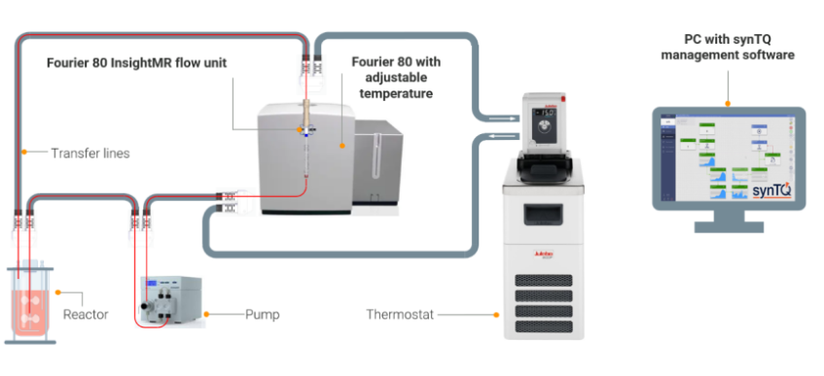
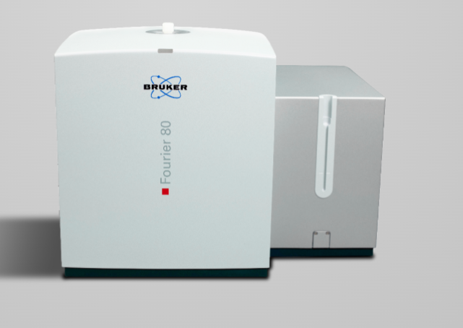

Slide 17
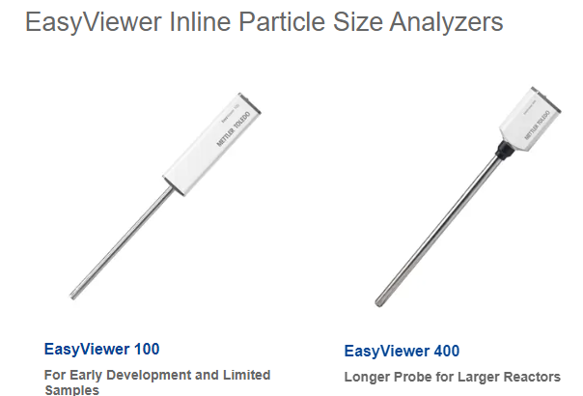
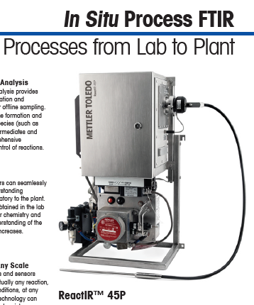
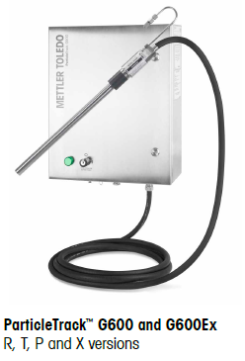

Slide 18
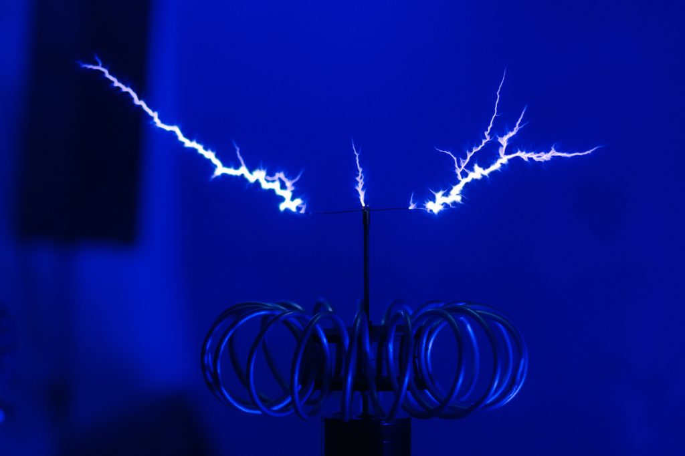
TRACE

Slide 19


Temperature, Resistance, Acid-Base and Conductivity Evaluator
$$T=45 ℃ ?$$
$$pH=5.6 ?$$

Slide 20
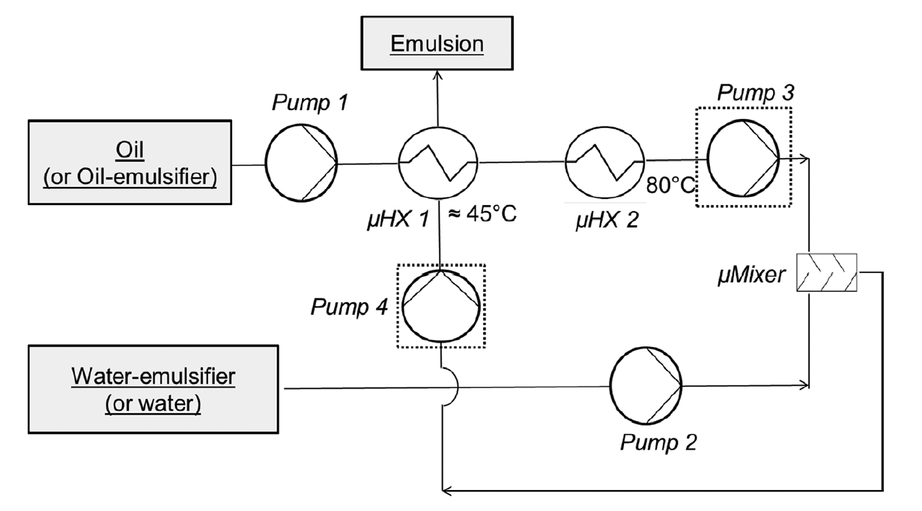
EMARSA

Slide 21
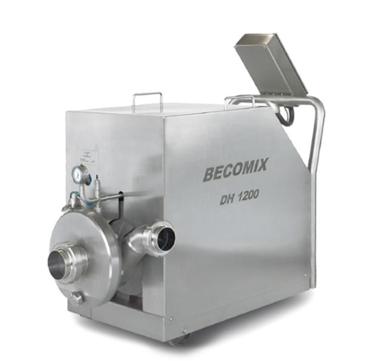
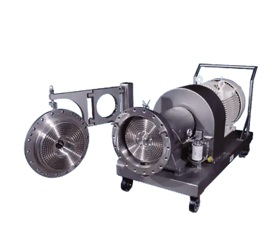
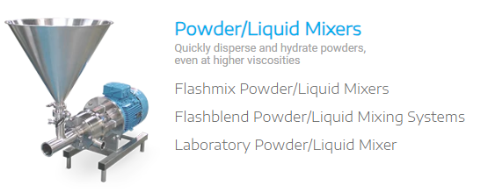
EMARSA
ROSS
TRACE
Energy balance
Droplet size/ appearance/ product homogeneity
Silverson
Raw material feeds/ valves openings
Energy recovery

Slide 22

PIVOT

Slide 23


Pressure, Inertia, Viscosity and Torque Monitoring System
$$η_{APP}=\frac{τ}{\dot{γ}}$$
$$\vec{τ}= \vec{r} × \vec{F}$$

Slide 24
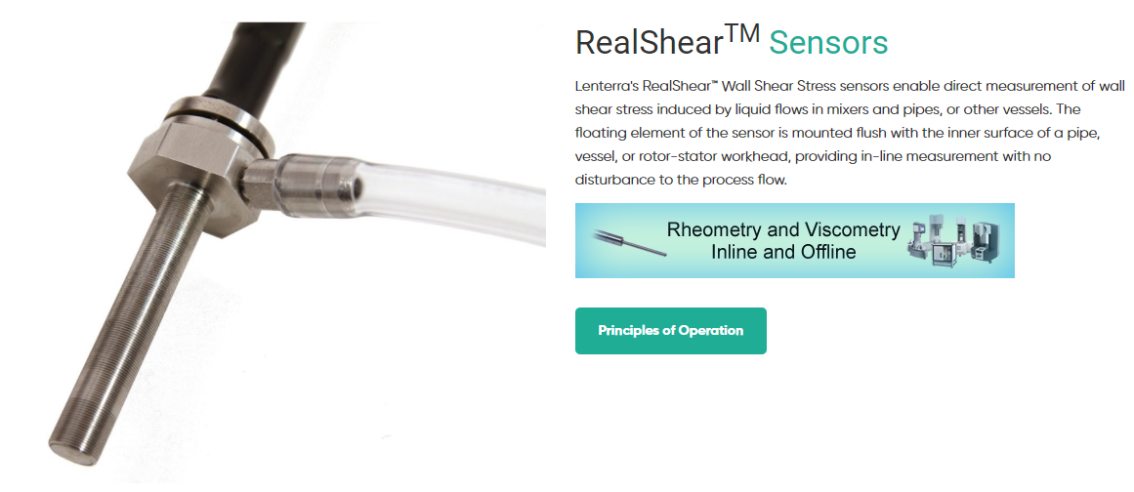


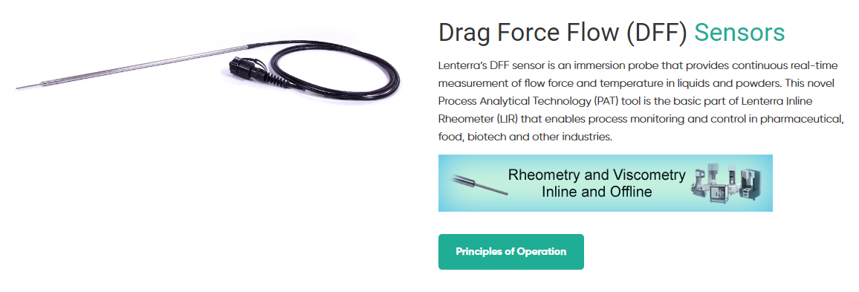
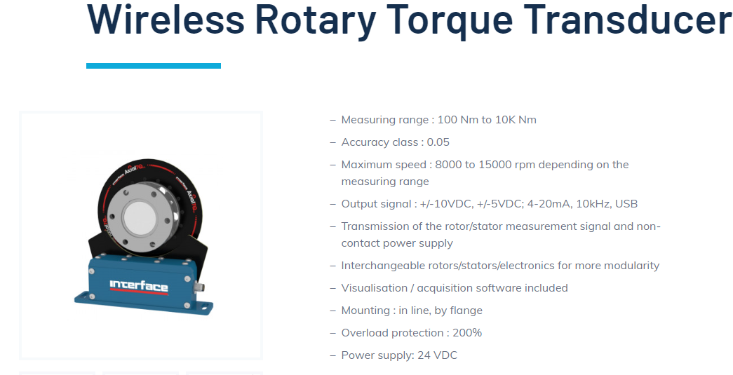
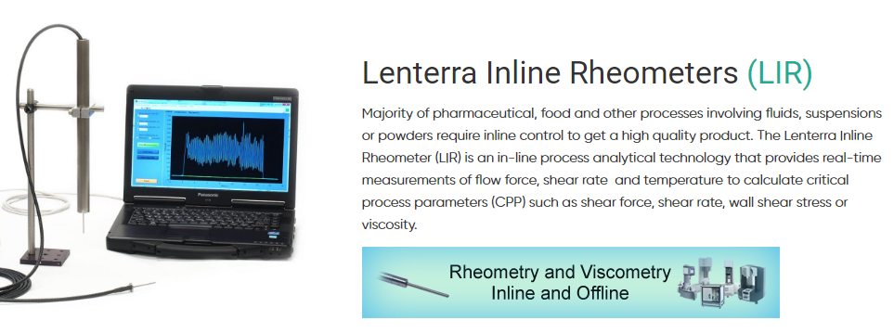

Slide 25

HARP

Slide 26
Hyper Aggregation and Real – time Processing

Slide 27


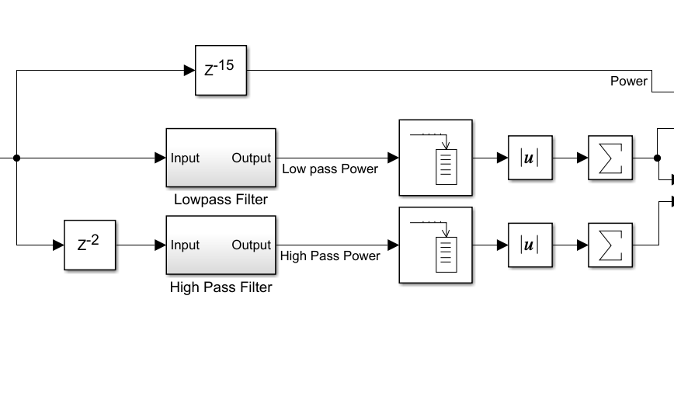
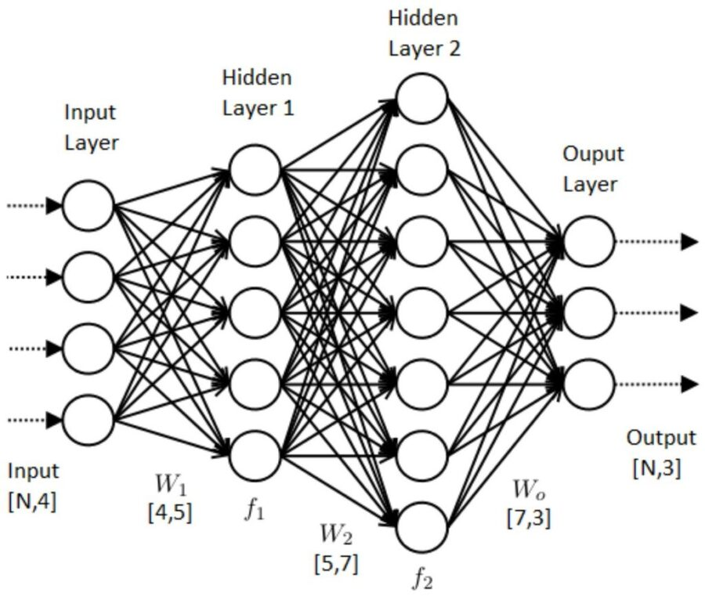



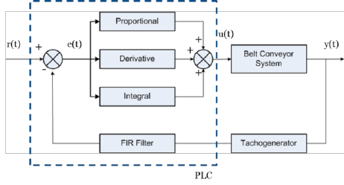



Motor Branch – Work by Reflex
Cognitive Branch – Work by Learning
Data & Feedback from the process
Design control systems & Simulate
Learn from experience
Physical processes
Enforce and monitor
Commands

Slide 28
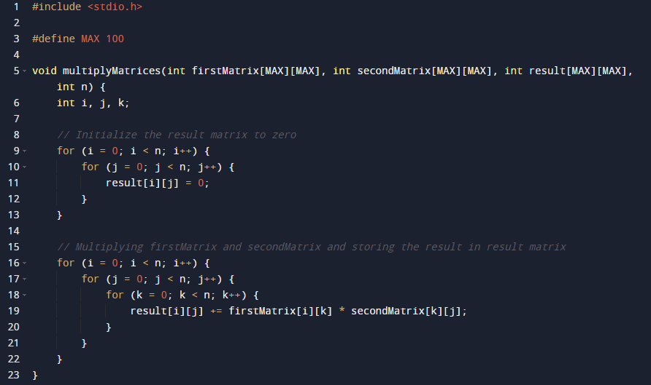
HPC

Slide 29
High Performance Computing
#include <stdio.h>
#include <cuda_runtime.h>
#define N 16
// CUDA kernel to perform matrix multiplication
__global__ void matrixMulCUDA(int *a, int *b, int *c, int n) {
int row = blockIdx.y * blockDim.y + threadIdx.y;
int col = blockIdx.x * blockDim.x + threadIdx.x;
int sum = 0;
if (row < n && col < n) {
for (int k = 0; k < n; ++k) {
sum += a[row * n + k] * b[k * n + col];
}
c[row * n + col] = sum;
}
}

Slide 30
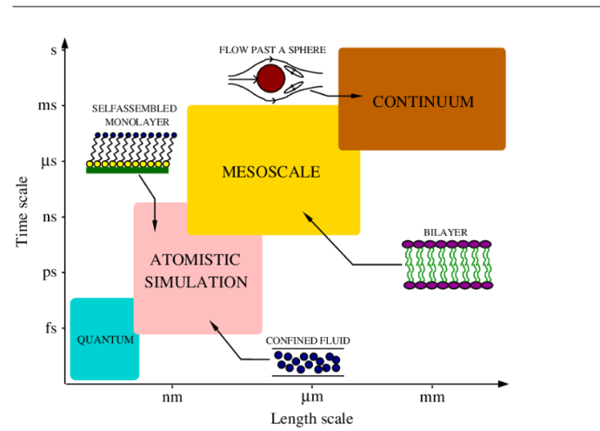
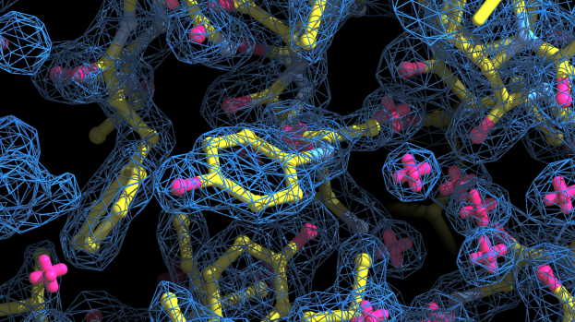


Slide 31







Excited States
The ONIOM (short for 'Our own N-layered Integrated molecular Orbital and Molecular mechanics

Slide 32





NVIDIA DGX A100
US$ 200000

Slide 33






Large-scale Atomic/Molecular Massively Parallel Simulator

Slide 34



Slide 35



“No task is beneath me because, remember, I used to be a dishwasher [and] I used to clean toilets. I’ve cleaned more toilets than all of you combined — and some of them you just can’t unsee

Slide 36

Thanks!
Or does it ?
}
return 0;
Specialist Cercetare, Ing. Sutu Dan -Valentin, Cercetare Dezvoltare, echipa Upgrade , Antibiotice S.A. Iasi

Slide 37







Dare
Mighty
Things

Slide 38




t (h) | e (visc) | C conc. biom | r (x${10}^{3}UI/g)$
0 | 9.79 | 0 | 0
56 | 32.6 | 55.1 | 33.6
80 | 54.6 | 66.0 | 38.1
104 | 72.5 | 73.7 | 38.1
128 | 76.2 | 79.3 | 33.5
152 | 80.1 | 83.3 | 30.6
176 | 84.3 | 86.1 | 28.3
200 | 88.7 | 83.9 | 24.1
224 | 93.2 | 82.6 | 22.3
248 | 98.1 | 79.8 | 14.3
Ecuatiile de miscare, scrise in sitemul natural de coordonate polare cilindrice sunt:
Directia radiala: $−\frac{ρv_{0}^{2}}{r}=\frac{1}{r} \frac{∂\left(rT_{rr}\right)}{∂r}−\frac{T_{θθ}}{r} (1)$
Directia azimutala: $0 =\frac{∂(r^{2}τ_{rθ})}{∂r} (2)$

Slide 39

Etapa 1) Preprocesarea datelor
Prerprocesarea este esentiala in aceasta aplicatie de machine learning. O prima etapa o presupune scalarea si normalizarea datelor, apoi standardizarea (scalare astfel incat media sa fie 0 si deviatia standard 1). Setul de date este splitat in doua seturi. Unul de training si unul de testare. Acest lucru e important pentru a evalua performanta modelului pe date noi. Am folosit din libraria de machine learning scikit-learn, functia train_test_split si am folosit test_size = 0.2. Asta inseaman ca 20 % din date sunt rezervate pentru testare.
Etapa 2) Construirea modelului neuronal
2.1. Straturile in reteaua neuronala
Stratul Input – Nu e un strat de calcul neaparat.
Straturile ascunse -Fiecare strat e facut din neuroni care iau suma weighted a outputurilor de la straturile precedente, aplica o functie de activare si transmit rezultatul la stratul urmator. Cu cat mai multe straturi ascunse (implicit, mai multi neuroni/strat), cu atat modelele pe care reteaua neuronala le poate invata sunt mai complexe.
Stratul Output – Numarul de neuroni din acest strat depinde de task (ex. Un neuron pentru clasificare binara, unul pe clasa, pentru clasificarea multiclasa, unul pentru regresie).
1/8 (input-128/8, hidden 64/8, output- 1)

Slide 40


2.2. Neuronii (Nodurile) – Fiecare neuron din strat realizeaza o suma de tip weighted a inputurilor, adauga un termen de bias, aplica o functie de activare, dupa cum urmeaza (Fig. 20).
Output = activation(weighted_sum(inputs) + bias)
2.3. Functia de activare. Descrisa partia lmai sus, e cruciala deoarece introduce proprietati neliniare retelei, si-i permite sa invete relatii complexe. Functia de activare folosita in acest caz este ReLU (Rectified Linear Unit).
$f\left(x\right)=\left\{\begin{aligned}x, x>0 \\ 0, x≤0\end{aligned}\right.$ si $f^{′}\left(x\right)= \left\{\begin{aligned}1, x>0 \\ 0, x≤0\end{aligned}\right.$
2.4. Weights (grautati) si biases. Acestea reprezinta partile invatabile ale retelei neuronale. In timpul trainingului reteaua ajusteaza parametrii ca sa optimizeze eroarea la predictii.

Slide 41



Etapa 3) Trainingul retelei neuronale
Trainingul e un process critic in care reteaua invata din datele puse la dispozitie ajustand greutatile si biasurile pentru a minimiza eroarea. Acest process implica niste componente cheie si procese, dupa cum urmeaza:
3.1. Forward Propagation – Datele sunt trecute prin retea de la stratul de input catre stratul de output. Fiecare neuron din strat proceseaza datele de input, aplica functia de activare si o trimite la urmatorul strat.
3.2. Functia de pierderi (Loss function) – Masoara cat de bine se descurca reteaua neuronala. Calculeaza diferenta dintre ceea ce reteaua prezice si valoarea target actuala. O functie destul de populara, care poate fi folosita pe postul de loss function este MSE (Mean squared error) pentru regresie si cross -entropy pentu clasificari.
3.3. Backpropagation – E procesul prin care reteaua neuronala invata. Dupa calculul parametrului loss, reteaua propaga eroarea in spate, de la stratul output la stratul input. Acest lucru presupune calcularea gradientului functiei loss in raport cu fiecare greutate si bias din retea.
3.4. Optimizatorul si rata de invatare – Optimizatorul updateaza greutatile si biasurile in directia in care minimizeaza functia loss. Foloseste tehnici precum SGD (Stochastic Gradient Descent), Adam, etc. In cazul de fata am folosit Adam (Adaptive moment estimation optimizer). Rata de invatare e un hiperparametru care controleaza cat de mult trebuie ajustate greutatile in raport cu gradientul functiei loss.
3.5. Epochs si Batches – O epoca (epoch) e o trecere completa prin intregul set de training. Trainingul unei retele neuronale implica de obicei mai multe epoci. Datele sunt imprtita in batches, si greutatile retelei sunt updatate dupa fiecare batch.

Slide 42


Predictii ?
Nistatina ATB 500000 UI, comprimate filmate
500000/ 38100 = 13 zile
500000 / 56000 = 9 zile
$P=UI\sqrt{3}\cos\left(φ\right)$ = 400 (V) * 400 (A) * $\sqrt{3}$ * 0.85 = 235.5 kW
E (/zi) = 235.5 (kW) * 24 = 5653 kWh
Pret/ zi = 5563 * 1.3 (lei/ kWh) = 7347 lei
Pret/ 4 zile = 7347 * 4 = 29390 lei (5800 euro)
t | e | C
0 | 12 | 0
50 | 35 | 54
60 | 55 | 67
66 | 54 | 76
70 | 53.9 | 80
80 | 55 | 85
85 | 57 | 90
100 | 54.2 | 85
110 | 56 | 84
160 | 53.7 | 82

Slide 43
Specialist Cercetare, Ing. Sutu Dan -Valentin, Cercetare Dezvoltare, echipa Upgrade , Antibiotice S.A. Iasi

