Slide 1


Antibiotice,
a first-rank company in the relationship with its investors*
Presentation for investors
October 2020
*According to the VEKTOR indicator of the Romanian Investors Relations Association(ARIR)

Slide 2
Disclaimer
Write it here
This presentation does not constitute and should not be construed as representing or being part of any current offer to sell or issue shares, or as a purchase or subscription request for any shares issued by Antibiotice S.A. No part of this presentation may be invoked in connection with any investment contract or decision nor does it constitute a recommendation regarding securities issued by Antibiotice S.A.These statements reflect the current knowledge of the company as well as the forecasts for future events, having an anticipatory character. By their nature, anticipatory statements are subject to a number of risks and uncertainties, many of which are beyond the control of Antibiotice SA which could determine the actual results and performance of the company to differ significantly from the results and performance expressed or suggested by the anticipatory statements.None of the forecasts, expectations, estimates or prospects in this presentation should be considered as certainties or promises, nor should they be considered as implying an indication, assurance or guarantee that the assumptions based on which the future forecasts, expectations, estimates or perspectives were elaborated are complete.This presentation is not intended to contain all the information that may be required regarding Antibiotice SA or its shares and each person receiving this presentation must make an independent assessment.The trading company undertakes no obligation to publicly release the results of any revisions to these anticipatory statements contained in this presentation that may arise as a result of changes in its forecasts or to reflect events or circumstances occurring after the date of this document. This presentation and its content are the Antibiotice S.A. property and no part of this document may be reproduced or redistributed to another person.

Slide 3
Contents
Write it here
Company profile
Development strategy
H I 2020: activity and results

Slide 4
Company Profile

Slide 5
Antibiotice in brief
Write it here
Antibiotice today
Mission
The main manufacturer of generic anti-infective medicines in Romania.
World leader in production of the active substance Nystatin: 65% which is a USP reference standard.
Invests 5% of its turnover in research-development projects.
Social Responsibility programs supported by the „Antibiotice - Science and Soul” Foundation.
A 150-product portfolio from 12 therapeutic classes.
We make our valuable medicines more accessible to patients, physicians and pharmacists. We always put our strength to the service of those who need our support.
BVB: ATB | 2019 | H I 2020
Turnover (thousand LEI) | 391,7 | 146,4
Stock market capitalization (million LEI) | 341 | 359,2
Number of shares (million) | 671 | 671

Slide 6
Leader in an attractive market
Write it here
Domestic position and market share
Performance in the external market
#1
Leader in the antiinfectives class in the generic category (31.06% market share)
#1
Leader in the hospital segment, RX and OTC medicines (15.6%)
#1
Leader in terms of quantity in the following segments: ointments (23.9%), suppositories (42.5%) and injectable powders (72,9%)
#4
Among the 129 prescription generic manufacturers (8.07%)
#20
In the total pharmaceutical market (1.89%)
40%
of turnover represents exports
$10 mil
The largest Romanian exporter în Vietnam
#1
World leader in the Nystatin market
2019 values

Slide 7
A company with a rich tradition
Write it here
1955-1990
- The first manufacturer of penicillin in Romania and South-East Europe
1990-2000
- Antibiotice becomes a joint stock company
2000-2010
-Modernization investments
2010-2015
-Increased exports
2015-2020
- Our company becomes an ARIR member
- Listing on the Stock Exchange Bucharest
- FDA authorization for Nystatin
- ATB shares in the BET index
-World leader in the production of Nystatin
- Over 750 million shares traded on the Stock Exchange in 23 years
-Opening its own Medicine Evaluation Center

Slide 8
Financial performance
Write it here
A profitable company

Slide 9
Antibiotice, a responsible company
Write it here
Health
Blood donation campaigns
First aid courses for our employees
Education
„Science and Soul” Scholarships, a program to support the children in rural areas
Environment
Programs for protecting the environment – “Be Pro Nature! Put your Soul!”
Social
Social programs through the „Antibiotice – Science and Soul” Foundation

Slide 10
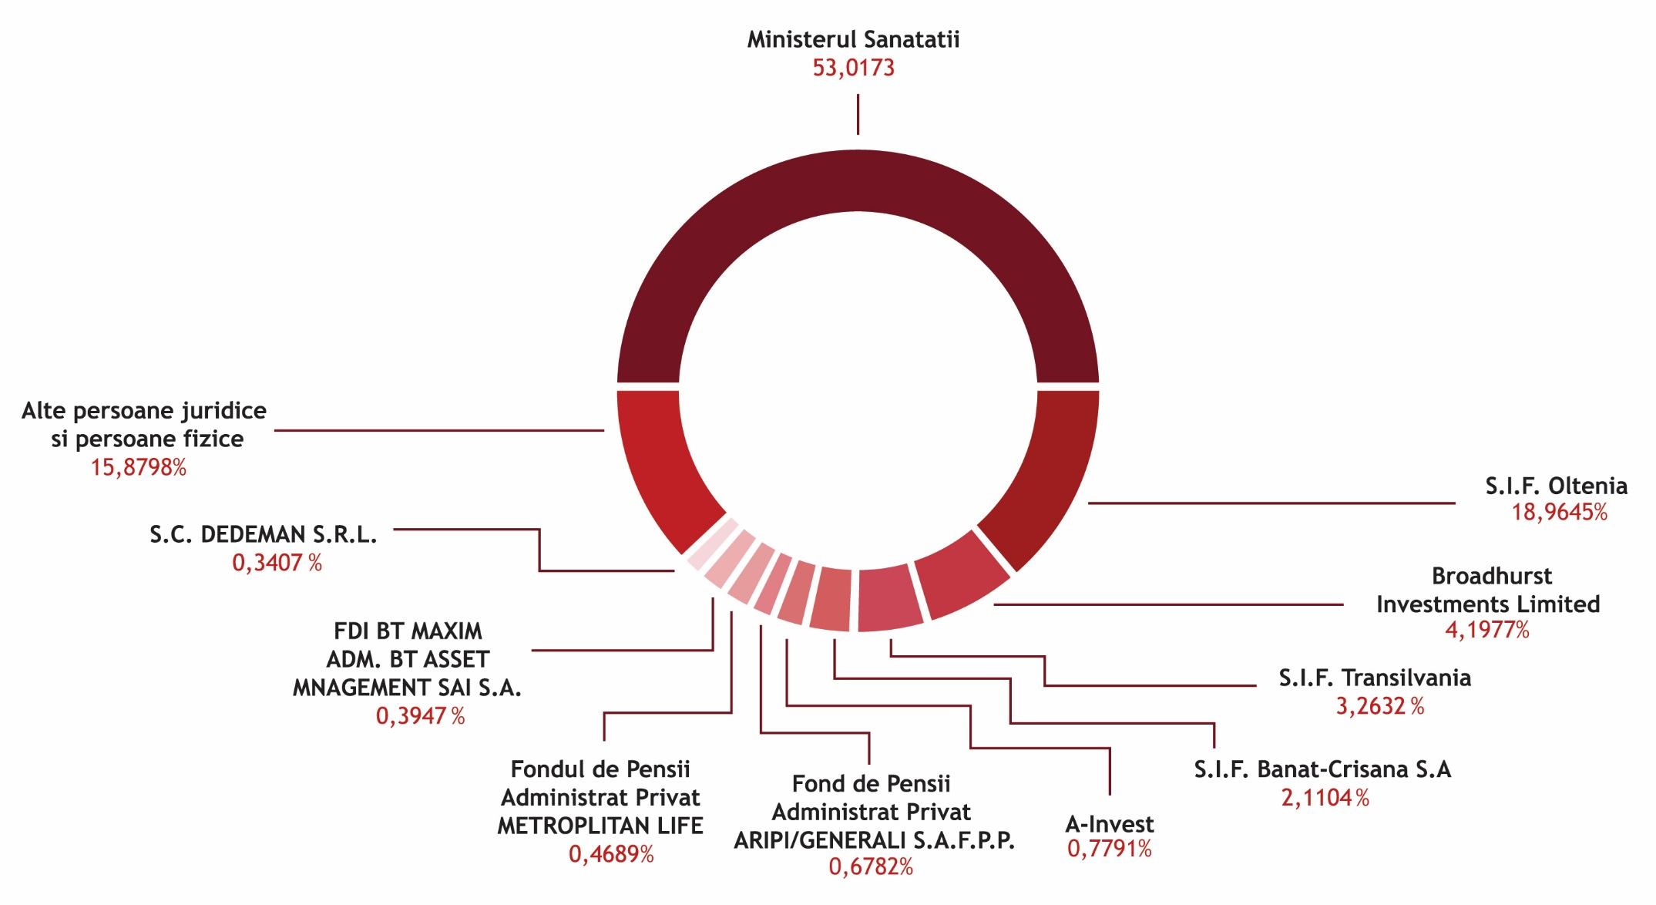
Shareholding
Write it here
La data de 30.06.2020

Slide 11
Development strategy

Slide 12
Strategic development pillars
Write it here
Internationalization of our business and its consolidation in the domestic market
Strategic adaptation of our portfolio
Investments – the guarantee of the future
Adapting human resources to strategic directions
Integrated Quality Management
+ Quick adapting to the extraordinary pandemic situation

Slide 13
Evolution of the main economic-financial indicators
Write it here
No. | Indicators | 2000 | 2005 | 2010 | 2015 | 2020 – valori estimate
1. | Turnover(mil. LEI), of which: | 62,2 | 163,5 | 243,6 | 331,7 | 377,7
2. | Export sales (mil. LEI) | 12,1 | 20,4 | 57,1 | 92,7 | 158,0
3. | Operating income(mil. LEI) | 61,9 | 164,8 | 248,5 | 342,1 | 394,3
4. | Operating expenses (mil. LEI) | 49,6 | 138,5 | 217,9 | 304,3 | 361,1
5. | Operating profit (mil. LEI) | 12,3 | 26,3 | 30,6 | 37,8 | 33,2
6. | Total income (mil. LEI) | 63,2 | 166,5 | 262,8 | 349,9 | 400,0
7. | Total expenses (mil. LEI) | 57,3 | 142,8 | 244,3 | 317,9 | 375,5
8. | Gross profit (mil. LEI) | 5,9 | 23,7 | 18,5 | 32,0 | 24,5
9. | Operating profitability | 19,8% | 16,1% | 12,6% | 11,4% | 8,8%

Slide 14
Write it here
No. | Indicators | 2000 | 2005 | 2010 | 2015 | 2020 – estimated values
10. | Gross profitability | 9,5% | 14,5% | 7,6% | 9,6% | 6,5%
11. | Fixed assets (mil. LEI) | 38,9 | 85,6 | 168,4 | 195,5 | 389,7
12. | Current assets (mil. LEI) | 38,4 | 126,2 | 223,9 | 327,3 | 436,0
13. | Total assets (mil. LEI) | 77,5 | 211,8 | 392,7 | 524,5 | 825,7
14. | Total liabilities (mil. LEI), of which: | 27,5 | 56,2 | 110,6 | 138,4 | 302,7
15. | Current liabilities (mil. LEI) | 26,5 | 54,4 | 110,6 | 122,2 | 219,9
16. | General liquidity (Current assets/Current liabilities) | 1,4 | 2,3 | 2,0 | 2,6 | 1,98
17. | Global solvency (Total assets/Total liabilities) | 2,8 | 3,7 | 3,5 | 3,8 | 2,7
18. | Added value | 33,2 | 90,2 | 128,7 | 173,4 | 197,8

Slide 15
Write it here
Responsibility, Cooperation and Partnerships
Analysis, evaluation and limitation of expenses corroborated with achieved revenues and urgent needs;
Balance of financial flows of receipts and payments, on each currency to limit financial expenses;
Sustained investments for future development;
Partnerships with customers and suppliers.

Slide 16
Internationalization of our business and its consolidation in the domestic market
Write it here
Strategic objectives
50
Nystatin, active substance - strengthening our world leadership position
Increasing product sales in both Antibiotice and assimilated territories
Territorial expansion through portfolio development and access to new markets
4
internationally registered products
countries with Antibiotice representative offices: Vietnam, Republic of Moldova, Ukraine, Serbia
6
new internationalization projects
(4 projects for finished products and 2 projects for Nystatin)

Slide 17
Strengthening the internal market
Strategic objectives
#1
Strengthening the leading position on the hospital segment by adapting our portfolio and commercial policies
#1
Strengthening the leading position on the Anti-infectives class – generic medicines
#1
Strengthening the leading position in terms of quantity on the topical segment to make the most of the investment in the most modern flow of topical products in the South – East of Europe
#4
Consolidation of our position in the top 5 manufacturers of prescription generic medicines by completing the portfolios for chronic diseases (diabetes, cardiovascular conditions)
29%
Development of the non-RX portfolio on the concepts Quality of Life, Women's Health, Nutriensa
Media
Increasing and consolidating the awareness of Nutriensa brand
National chains
Development of integrated partnerships with national chains for the fruition of production capacities

Slide 18
Strategic adaptation of our portfolio
Write it here
Write it here
Strategic objectives
Therapeutic areas
Increasing sales in the hospital portfolio
Increasing the production capacity of topicals
Development of new products in all the therapeutic areas
Injectable and oral antiinfectives
Topical medicines
Nutriensa
Women's health
Cardiovasculars
Sterile solutions
150
Products in the portfolio

Slide 19
Investments – the guarantee of the future
Write it here
Building a new manufacturing plant for ointments and suppositories | 20 mil EUR
Building a new manufacturing plant for sterile solutions | 60 mil EUR
Upgrading, diversifying the assortment range and increasing the capacity for manufacturing the active substance Nystatin | 10 mil EUR
Research investments | 10 mil EUR
Upgrading the existent manufacturing capabilities | 5 mil EUR
Investments in the Product Quality Control | 5 mil EUR
Investments in the IT infrastructure | 5 mil EUR
Environmental protection, Occupational Safety and Health | 2 mil EUR
Indicators (mil. LEI) | 2020 | 2025
Turnover | 377,7 | 710
- export sales | 158 | 332
% export in Turnover | 42% | 45%
Gross profit | 24,5 | 70
Claw back tax | 32,4 | 54,3
Gross profit+claw back | 56,9 | 124,3
Average number of employees | 1,415 | 1,300

Slide 20
Adapting human resources to the company’s strategic directions
Write it here
Strategic objectives
Qualified personnel
Supporting professional development
Balanced staff structure
Improving organizational climate
Increasing our employees’ motivation
1,415
employees
45%
Specialists with
higher education
3
Partner universities

Slide 21

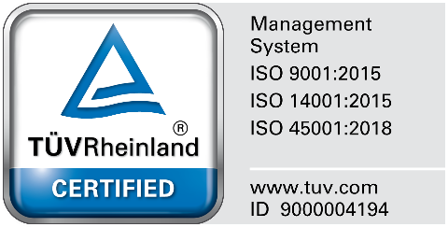


Integrated quality management
Write it here
Integrated quality management system
(quality, environment, occupational health and safety)
International quality certifications:
EU-GMP for 8 manufacturing flows;
US - FDA for sterile injectable powders and Nystatin API;
CoS (Certificat of Suitability) issued by EDQM in 2004, renewed in 2008;
TÜV Rheinland certificate for integrated management (quality, environment, occupational health and safety);
Multiple approvals for external custormers (about 20 annual audits)
Objective:
Supporting the business
partnerships

Slide 22
Rapid adaptation to the extraordinary pandemic situation
Write it here
State of emergency
Strategic objectives
ATB crisis cell
Supporting the Romanian medical system with medicines of strict necessity, during the pandemic
Maintaining the health and safety of our employees present on the manufacturing site and continuing the company’s activity.
Scenario 1
Reducing indirectly productive activities, work from home
Scenario 2
complete interruption of indirectly productive activities and limitation of the production ones
Scenario 3
stopping productive and unproductive activities and ensuring security, ISU, site monitoring

Slide 23
Effective protection measures in a crisis situation
State of alert
Adopted measures
H I 2020 results
Measures for protecting our employees
Protection outfits & disinfectants
Monitoring the state of health through periodic medical controls
- Testing the personnel (PCR/quick tests) upon returning to the company after the state of emergency/vacation;
Social distancing
- Flexible work hours;
- Work from home;
Online meeting platform - Microsoft teams
Isolation Center a+
Communication - informing our employees by using e-mail, FB, posters at work, access area and own means of transport
0
Coronavirus-infected employees
0
Days of production interruption

Slide 24
Performance indicators for the executive team
Write it here
INDICATORS for EXECUTIVE ADMINISTRATORS | Weighting | 2020
Sales revenues (mil. LEI) | 10% | 376,96
Gross profit (mil. LEI) | 15% | 24,50
Arrears (mil. LEI) | 15% | 0
Total expenses per 1000 lei income | 10% | 939
Degree of utilization of production capacity not less than 60% | 10% | 60%
Government social policies (gender equality, employment, health) | 10% | 100%
Achieving a degree of customer satisfaction in the internal market of at least 80% | 10% | 80%
Average number of continuing education hours per employee | 10% | 32
Monitoring the transparency and communication processes | 10% | 100%

Slide 25
Semester I 2020: activity and results

Slide 26
Achievements in the first semester of 2020
Write it here
146.4 million LEI registered revenues, of which 50% export revenues
Maintaining the position of world market leader for the active substance Nystatin
Adapting the production to the extraordinary pandemic situation
Effective protection measures: no coronavirus cases among our employees
Maintaining a balanced evolution of income-expenditure-profit indicators
Continuation of the investment program for the future

Slide 27
Revenues achieved according to market dynamics
Write it here
Market dynamics
Results
Dynamics of the pharmaceutical market was affected by the pandemic
The demand for anti-infectives associated with the Covid-19 treatment increased.
The number of consumers in open-circuit and number of hospitalizations decreased.
146.4 mil. LEI revenues, of which 50% revenues from export;
The position of world leader in the market of Nystatin was maintained;
The consumption of Antibiotice medicines in hospitals grew by 6.4%

Slide 28
Strategic adaptation of our portfolio
Write it here
Achivements
A new manufacturing structure
Reintroducing into manufacturing the medicines Paracetamol and Novocalmin for Covid-19;
Speeding the research-development project of the product Hydroxychloroquine
Accessing new markets with the product AmoxiPlus (Amoxicillin/Clavulanate sterile injectable powder 1.2 g): Great Britain and Ukraine.
Research and testing of three types of disinfectants and production of 2 types of surface disinfectants
26 dossiers submitted for authorization and 7 dossiers for re-authorization
Oral Solids Division
integrates the activities of the Capsule Plant and Tablet Plant
Topicals Division
includes the Ointment & Suppository Plant
Sterile Products & Nystatin Division
integrates the activities of the Parenteral Product Plant and Biosynthesis Plant

Slide 29
Continuation of the investment program for the future
Write it here
Investments amounting to 25.97 million LEI, of the total amount of 78.91 million LEI for the investment program 2020

Slide 30
Effective protection measures in a crisis situation
State of alert
Adopted measures
H I 2020 results
Measures for protecting our employees
Protection outfits & disinfectants
Monitoring the state of health through periodic medical controls
- Testing the personnel (PCR/quick tests) upon returning to the company after the state of emergency/vacation;
Social distancing
- Flexible work hours;
- Work from home;
Online meeting platform - Microsoft teams
Isolation Center a+
Communication - informing our employees by using e-mail, FB, posters at work, access area and own means of transport
0
Coronavirus-infected employees
0
Days of production interruption

Slide 31
Balanced economic activity
Write it here
Indicators | 30.06.2019 | 30.06.2020 | 06.2020/ 06.2019
Sales income(mil. LEI) | 172,4 | 146,4 | 0,85
Gross profir (mil. LEI) | 24,9 | 19,4 | 0,78
Arrears (mil. LEI) | 0 | 0 | 1,00
Total expenses to 1,000 LEI income | 879 | 894 | 0,98
Maintaining a balanced evolution of income-expenditure-profit indicators compared to 2019, in economic crisis conditions

Slide 32
Comprehensive income statement
Write it here
Financial indicators (LEI) | 30.06.2019 | 30.06.2020 | 30.06.2020/30.06.2019
Sales income | 172.391.095 | 146.377.930 | 0,85
Other operating income | 18.686.567 | 22.243.720 | 1,19
Revenues related to the costs of product stocks | 26.243.033 | 26.727.927 | 1,02
Capitalized income from the activity performed by the entity | 2.568.485 | 3.295.615 | 1,28
Expenditure on raw materials and consumables | 78.018.365 | 66.398.931 | 0,85
Staff costs | 46.888.473 | 50.146.132 | 1,07
Depreciation and amortization expenses | 10.329.494 | 10.959.958 | 1,06
Other operating expenses | 57.508.252 | 48.771.227 | 0,85
Operating profit | 27.144.596 | 22.368.945 | 0,82
Net financial income | -2.220.989 | -3.017.557 | 1,36
Pre-tax profit | 24.923.607 | 19.351.388 | 0,78
Tax expenses | 2.604.531 | 206.134 | 0,08
Net profit | 22.319.076 | 19.145.254 | 0,86

Slide 33
Financial statement: assets
Write it here
Financial indicators (LEI) | 31.12.2019 | 30.06.2020 | 30.06.2020/31.12.2019
ASSETS
FIXED ASSETS
Tangible fixed assets | 363.616.611 | 379.243.099 | 1,04
Intangible fixed assets | 16.385.709 | 18.062.450 | 1,10
TOTAL FIXED ASSETS | 380.002.320 | 397.305.549 | 1,05
CURRENT ASSETS
Stocks | 73.975.988 | 114.080.189 | 1,54
Trade and similar receivables | 338.159.774 | 272.878.955 | 0,81
Cash and cash equivalents | 1.877.409 | 3.861.622 | 2,06
TOTAL CURRENT ASSETS | 414.013.171 | 390.820.766 | 0,94
TOTAL ASSETS | 794.015.491 | 788.126.315 | 0,99

Slide 34
Financial statement: liabilities
Write it here
Financial indicators (lei) | 31.12.2019 | 30.06.2020 | 30.06.2020 / 31.12.2019
LIABILITIES
CURRENT LIABILITIES
Trade and similar debts | 72.337.840 | 79.450.266 | 1,10
Amounts owed to credit institutions | 125.875.879 | 109.986.199 | 0,87
Debts from current taxes and fees | 13.267.396 | 5.690.516 | 0,43
Investment grants
TOTAL CURRENT LIABILITIES | 211.481.115 | 195.126.981 | 0,92
LONG-TERM LIABILITIES
Investment grants | 3.079.169 | 2.926.024 | 0,95
Deferred tax | 25.531.938 | 25.738.072 | 1,01
Amounts owed to credit institutions | 57.080.354 | 68.406.475 | 1,20
TOTAL LONG-TERM LIABILITIES | 85.691.461 | 97.070.571 | 1,13
TOTAL LIABILITIES | 297.172.576 | 292.197.552 | 0,98

Slide 35
Financial statement: share capital and reserves
Write it here
Financial indicators (LEI) | 31.12.2019 | 30.06.2020 | 30.06.2020/31.12.2019
Share capital and reserves
Share capital | 264.835.156 | 264.835.156 | 1,00
Revaluation reserves | 50.804.319 | 49.499.028 | 0,97
Legal reserves | 13.426.761 | 13.426.761 | 1,00
Other reserves | 200.655.367 | 204.149.957 | 1,02
Retained earnings | -56.432.683 | -55.127.392 | 0,98
Distribution of profit | -7.269.283 | 0
Current result | 30.823.278 | 19.145.254 | 0,62
TOTAL EQUITY | 496.842.915 | 495.928.763 | 1,00
TOTAL CAPITAL AND DEBT | 794.015.491 | 788.126.315 | 0,99

Slide 36
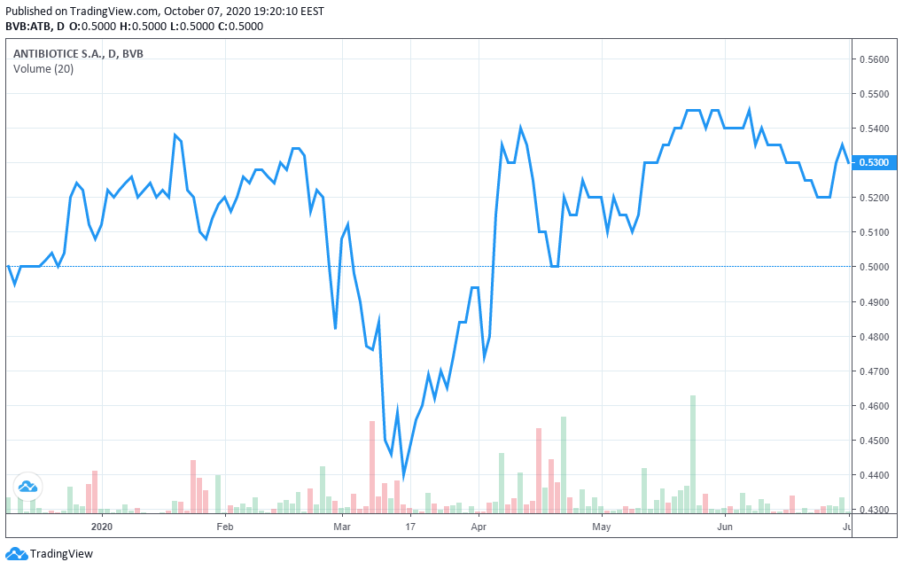
ATB shares on the Stock Exchange
Write it here
10,404,214 shares, with a total value of 1,105,555 EUR were traded.

Slide 37
Conclusions
Write it here
Market leader in an attractive sector
An ambitious and responsible development strategy
Performance indicators in line with the strategy
Quick adaptation to extraordinary situations
A first ranked company in the relationship with the investors

Slide 38
Contact pentru investor relations
Website: www.antibiotice.ro/investitori-php/
Email: relatiicuinvestitorii@antibiotice.ro
www.antibiotice.ro

