Slide 1
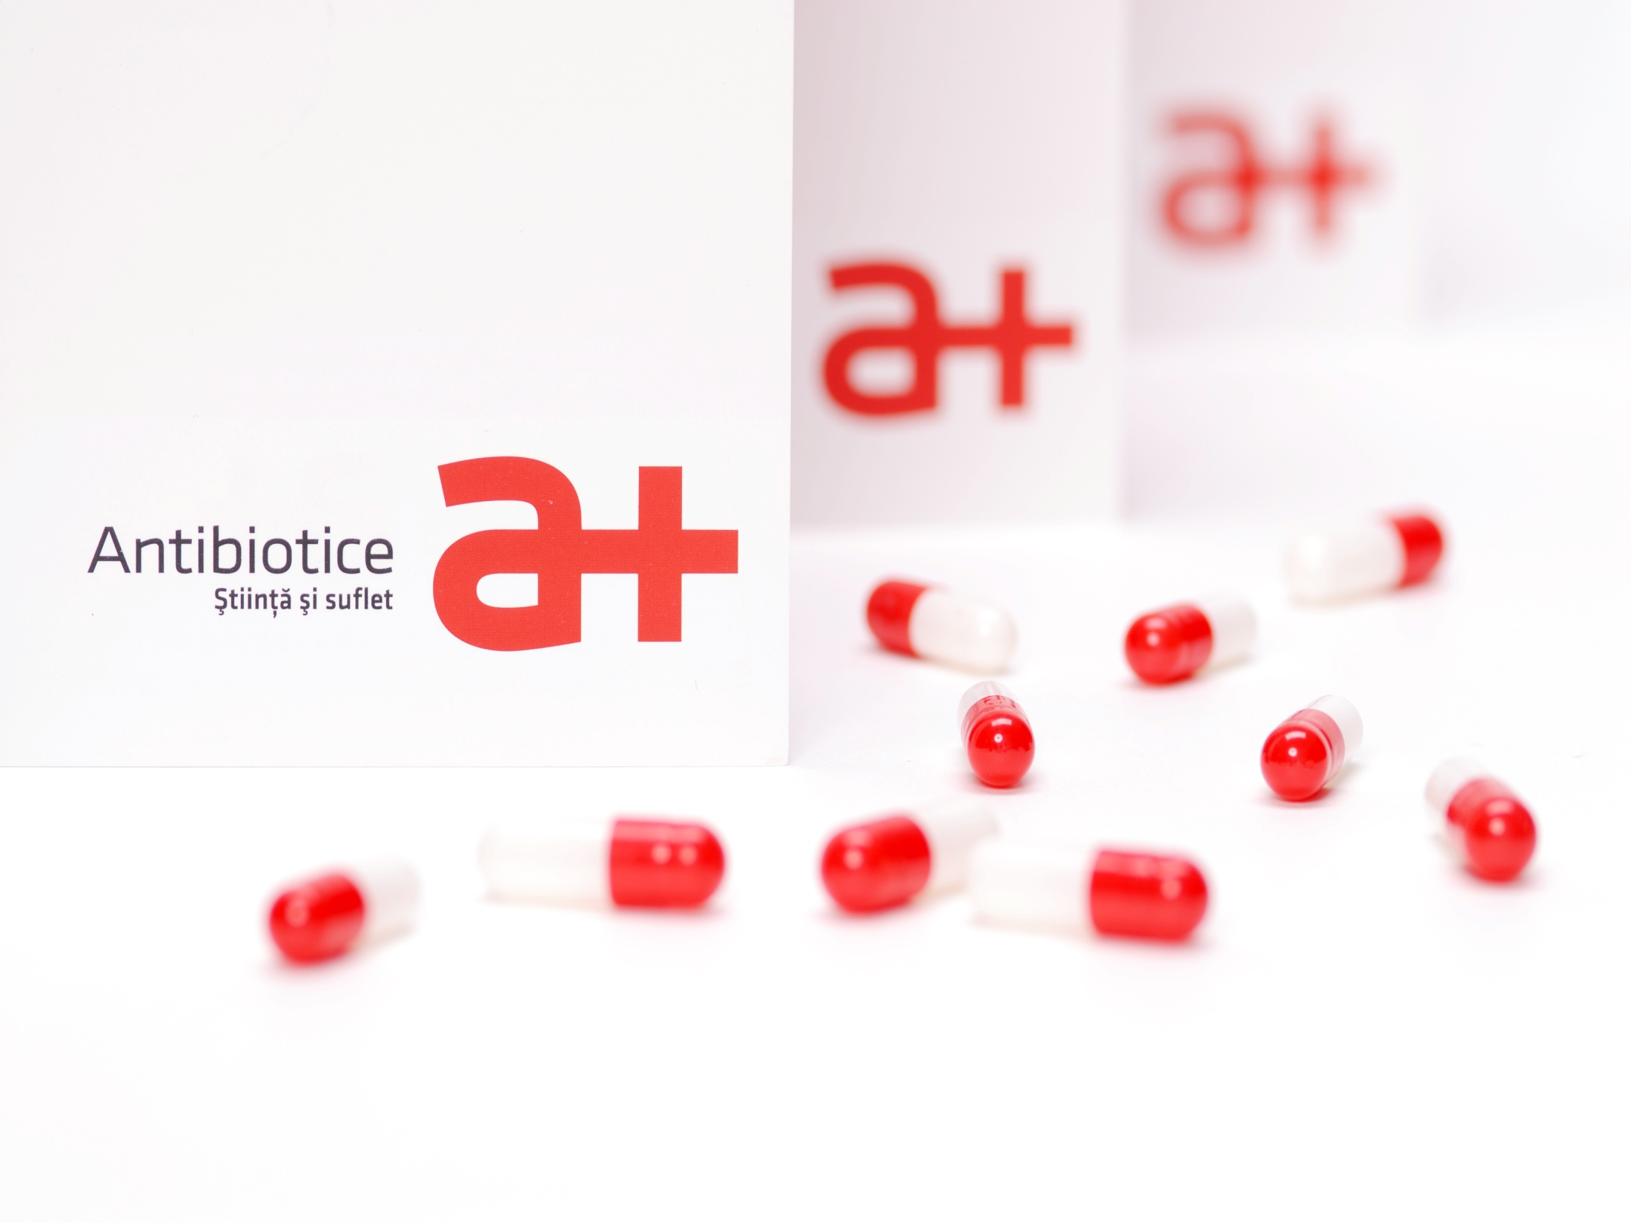
Prezentare companie

Slide 2
Tradition means continuity and recognition
1955 | Only a decade after the synthesis of Penicillin, Antibiotice, the first manufacturer of this active substance in Romania and South-Eastern Europe starts its activity.
1955-1990 | The manufacturing structure is developed, especially for active substances, sterile powders for injection, ointments and suppositories.
1990 – 2000 2000 - 2005 | A redefined manufacturing structure, investments in internal and international marketing for adapting our business to the market economy; Refurbished manufacturing plants; Listing on the Bucharest Stock Exchange – April 1997; A reconfigured human resource - generation exchange; Adoption of the RICOP program coordinated by the World Bank: - activities organized on profit centers and an outsourced distribution network-2000; - improved manufacturing technologies – Nystatin and Vitamin B12 – 2001 - removal of the active substances Ampicillin trihydrate and Oxacillin from manufacture - 2004; - an accelerated receivable collection - 2004. Significant investments (60 million EUR) in: - modernizing the production technologies, purchasing modern equipment for increasing our competitiveness; - optimizing the utilities production; - developing the product portofolio; - meeting the EU requirements in the environment protection; - certifying the quality systems for meeting the GMP and US FDA standards; - obtaining the FDA approval for Nystatin and sterile powders for injection; A new launched identity brand (a new logo a+ and a new slogan, “Science and soul”).
ATB symbol

Slide 3
Tradition means continuity and recognition
Pillar 1 Business internationalization and consolidation in the domestic market
Pillar 2 Adapting strategically the product portfolio
Pillar 3 Operating cost management
Pillar 4 Adapting the human resource to the strategic directions of the company
Pillar 5 Integrated quality management
Our company’s development through Strategic Plans
2010 - 2015 | Antibiotice delivers the first finished products certified by FDA in the US; World leader in the production of Nystatin, a strong focus towards business internationalization; Representative offices in the Republic of Moldova and Serbia; Establishment of its own Center for Drug Evaluation (CEM); The first WHO pre-qualified European company for anti-tuberculosis products.
2015 - 2020 | USP reference standard for Nystatin; Representative offices in : Vietnam și Ukraine; Product portfolio - 150 medicinal products in 12 therapeutic classes; A continuous international expansion of our business by obtaining new marketing authorizations.
2020-2025 | Maximizing the presence in the ATB territories; Strategies to expand the portfolio by increasing the number of generic products and stimulating innovation; Accelerated sustainable development through efficient investments in new production capabilities; Optimal staff structure and skills training to achieve the objectives; Obtaining and maintaining all the certifications necessary for the operation of the company and supporting business partnerships.
ATB symbol

Slide 4
Antibiotice in the capital market
ATB symbol

Slide 5
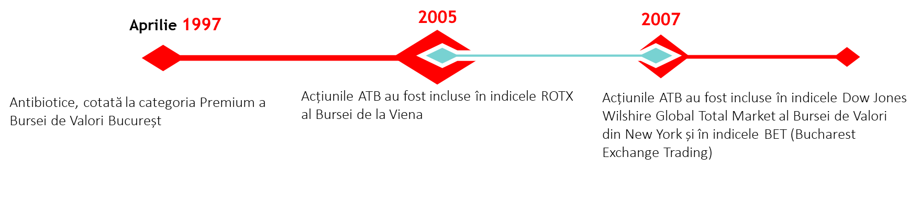
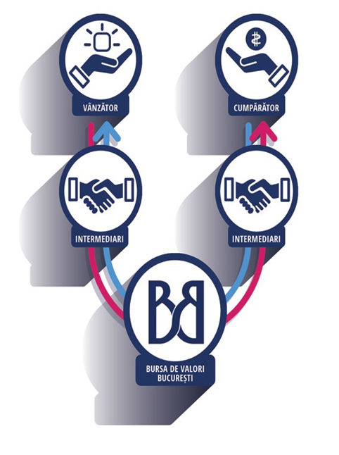
More than 740 milllion shares have been traded over 22 years of listing with a total trading value of over 276 million EUR.
Stock market capitalization 331,641,992 LEI
4,376,903 shares with a total value of 453,376 EUR were traded in the first 3 months of 2020.
Maximum price in the first three months 2020:
0.5400 LEI/share
ATB symbol
www.antibiotice.ro

Slide 6
Antibiotice today
A portfolio comprising 150 pharmaceutical products in 12 therapeutic classes;
8 manufacturing flows for: penicillins powder for solution for injection; penicillin capsules; non-beta-lactam capsules; cephalosporin capsules; tablets; ointments, creams, gels; pessaries; active substances obtained by biosynthesis;
Global leader in the production of Nystatin, active substance;
Leader in the production of beta-lactam antibiotics for injection in Romania;
Leader in the topicals segment (creams, ointments, gels) in Romania;
The main Romanian manufacturer of generic medicines;
5% of our turnover are invested in research – development projects;
Significant manufacturer of cardiovasculars, topicals for dermatological use, nonsteroidal anti-inflammatory medicines and medicines for the central nervous system.
ATB symbol
www.antibiotice.ro

Slide 7
Domestic market
Sales revenue recorded on 31.03.2020 by our company amounted to 73.63 million LEI, up 13% compared to the value recorded at the end of the first quarter of the previous year. This increase was determined by the 48.7% increase in the sales revenue in the Romanian market.
Sales revenues in the domestic market:
(mil. LEI)
Name of indicator* | 31.03.2019 | 31.03.2020 | ∆ 01 - 03 2020/2019
Net sales(domestic market) | 34.8 | 51.7 | 48.7%
Sell IN distribution | 82.4 | 95.3 | 15.6%
Sell OUT (Pharmacies + Hospitals) | 85.4 | 88.1 | 3.2%
In the context of the coronavirus pandemic:
our company's representatives kept in constant contact with the distributors, in order not to have syncopes in the supply of medicines and for the creation of stocks that would allow them to honour the orders in the shortest time;
our company's representatives kept in constant contact with the pharmacies from hospitals for identifying the need for medicines and fast delivering the orders;
Antibiotice offered financial support and donated medicines for 10 hospitals in Romania.
ATB symbol
www.antibiotice.ro

Slide 8
Antibiotice in Q I 2020 in the pharmaceutical market in Romania
Ranked 1st in the relevant market with a value market share of 13.8% at the end of Q I 2020;
Leader in terms of quantity to the following dosage forms: ointments (23.3%), suppositories and pessaries (44.2%) and powders for injection (71.1%);
Leader in the segment of generics & OTCs traded in hospitals, with a 16,5% market share;
Ranked 8th in the segment of generics & OTCs (with a 3.91%) market share;
Ranked 21st in the total pharmaceutical market (with a 1.83% market share).
ATB symbol
www.antibiotice.ro

Slide 9
Research & Development
The Research-Development activity has as its main objective the development of new medicines (topicals, tablets, capsules, sterile products and other new pharmaceutical dosage forms), in accordance with the strategic development directions of the company until 2025.
As regards the products under research in 2020, different research stages were completed in the first quarter for 12 projects, as follows:
three projects for the Sterile Products & Nystatin Division;
five new projects for the Topicals Division;
four new projects, of which two food supplements for the Oral Solids Division.
Three products were reauthorized (2 pessaries and 1 ointment) from the portfolio of the Topicals Division and a Notification was submitted to the competent authorities for a new food supplement for immunity.
We started the European procedures for registering two products from the anti-infective and cardiovascular classes.
CENTER FOR CLINICAL STUDIES
Antibiotice has its own Center for Clinical Studies – one of the most modern in Romania. It was founded în 2005, this investment amounting to over 10 million EUR.
In the Q1, the Center for Clinical Studies (CSC) started the clinical study for a topical product already approved by the National Bioethics Committee for Medicines and Medical Devices (CNBMDM).
This ongoing project is part of our company’s international expansion strategy.
Research - Development
ATB symbol
www.antibiotice.ro

Slide 10
Antibiotice supports the Romanian medical system
Our company resumed the production of Paracetamol and Novocalmin® because they have been included in most national guidelines in EU as the first option when initiating the treatment for fever or pain caused by the COVID 19 infection.
Successfully completed steps for manufacturing the hydroxychloroquine-based medicine, an effective medicine for seriously ill patients infected with SARS-CoV-2 virus.
Three types of disinfectants, under authorization:
  a hand sanitizer gel formula and
  two surface disinfectant formulas
ATB symbol
www.antibiotice.ro

Slide 11
Production of the Antibiotice company
135 million pharmaceutical units under the form of tablets, capsules, parenteral products, topicals (ointments, creams, gels), suppositories and pessaries;
139 thousand BOU active substance (Nystatin)
The total value of production in the first quarter of 2020 amounted to 101.2 million LEI, comparable to that achieved in the same period of 2019.
The production value of Nystatin, active substance and finished products sold in other territories, excluding Romania (27.45% of the total production value) rose by 14.2% compared to that achieved in the first quarter of I 2019.
Simbol ATB

Slide 12
Business internaționalization
Our business develops internationally in 2020 focusing on the following directions:
Nystatin API – to consolidate and maintain the leading position in the world market of the active substance Nystatin
Nystatin sales increased by 13% compared to the planned level and by 27% compared to the same period of 2019, reaching a value of about 18 million LEI.
With the relaxation of the legislative limitations imposed by the pandemic situation on deliveries outside Romania, the quantities of anti-infectives manufactured for export will significantly increase in the next period (in particular those of the penicillin range, combinations of penicillin, paracetamol). Demand is correlated with the governments' immediate need for medication associated with SARS-CoV2 infections and also for creating medium-term safety stocks.
to increase the sales in the territories in which we have representative offices
to expand territorially, the main pillar for a long-term growth focused on:
• developing the product portfolio in the current territories;
• accessing new markets in the ASEAN region, EU and Middle East, markets with a recognized consumption potential for anti-infective, dermatological and cardiovascular medication, traditional products for Antibiotice which is highly experienced in producing them.
ATB symbol

Slide 13
Actions completed in the first quarter of 2020
Clarithromycin tablets 500 mg, a new anti-infective product was launched in the Vietnamese market;
Our specialists conducted a market study and completed the negotiations by establishing a long-term partnership with a local distributor experienced in the retail segment for accessing the Vietnamese market with 3 new dermatological products;
We accessed the hospital segment in the Republic of Moldova by winning the tender for 3 antiinfective medicinal products;
Our company won the tender in Hungary for Amoxicillin/Clavulanic Acid 1,2 g sterile powder for injection in the project for accessing new European markets for anti-infective products;
We started the procedures for upgrading the file and the manufacturing for accessing the US market with two new anti-infectives for injection (Ampicilina/Sulbactam 1.5 g and 3 g) starting with June 2020;
We started the registration of two products (Meropenem sterile powder for injection and Lisinopril tablets) within the project for the Scandinavian countries;
A market study was conducted and negotiations were completed for accessing the Slovakia market with 4 anti-infective medicinal products, sterile poder for injection;
A market study was conducted and negotiations were completed for accessing the Germany market with 7 anti-infective medicinal products, sterile poder for injection;
ATB symbol

Slide 14
Comprehensive income statement
Comprehensive income statement (LEI) | 31.03.2019 | 31.03.2020 | 2020/2019
1 | 2 | 3 | 4=3/2
Sales revenue | 65.066.014 | 73.631.604 | 1,13
Other operating revenues | 8.952.087 | 6.716.382 | 0,75
Revenue related to the costs of product stocks | 16.661.315 | 14.301.700 | 0,86
Income from the activity performed by the entity and capitalized | 1.035.011 | 891.777 | 0,86
Expenditure on raw materials and consumables | 33.120.317 | 35.483.832 | 1,07
Staff costs | 23.718.951 | 23.225.551 | 0,98
Depreciation and amortization expenses | 5.159.090 | 5.519.475 | 1,07
Other operating expenses | 24.549.531 | 25.861.137 | 1,05
Operating revenue | 5.166.539 | 5.451.468 | 1,06
Financing costs | -1.032.744 | -1.259.835 | 1,22
Pre-tax profit | 4.133.795 | 4.191.633 | 1,01
Current and deferred income tax expenses | 864.384 | 111.024 | 0,13
Profit | 3.269.411 | 4.080.609 | 1,25
ATB symbol

Slide 15
Statement of financial position
Patrimonial elements (lei) | 01.01.2020 | 31.03.2020 | 31.03.2020 / 01.01.2020
1 | 2 | 3 | 4 = 3/2
ASSETS
FIXED ASSETS
Tangible fixed assets | 363.616.611 | 378.105.379 | 1,04
Intangible assets | 16.385.709 | 16.426.775 | 1,00
TOTAL FIXED ASSETS | 380.002.320 | 394.532.154 | 1,04
CURRENT ASSETS
Stocks | 73.975.988 | 86.687.280 | 1,17
Trade and similar receivables | 338.159.774 | 318.870.854 | 0,94
Cash and cash equivalents | 1.877.409 | 2.113.181 | 1,13
TOTAL CURRENT ASSETS | 414.013.171 | 407.671.315 | 0,98
TOTAL ASSETS | 794.015.491 | 802.203.469 | 1,01
LIABILITIES
CURRENT LIABILITIES
Trade and similar debts | 72.337.840 | 74.066.736 | 1,02
Amounts owed to credit institutions | 125.875.879 | 121.473.192 | 0,97
Debts from current taxes and fees | 13.267.396 | 10.112.983 | 0,76
TOTAL CURRENT LIABILITIES | 211.481.115 | 205.652.911 | 0,97
LONG-TERM LIABILITIES
Investment subsidies | 3.079.169 | 3.002.597 | 0,98
Deferred tax | 25.531.938 | 25.642.962 | 1,00
Amounts owed to credit institutions | 57.080.354 | 66.981.476 | 1,17
TOTAL LONG-TERM LIABILITIES | 85.691.461 | 95.627.035 | 1,12
ATB symbol

Slide 16
Statement of financial position
TOTAL LIABILITIES | 297.172.576 | 301.279.946 | 1,01
Share capital and reserves
Share capital | 264.835.156 | 264.835.156 | 1,00
Revaluation reserves | 50.804.319 | 50.151.664 | 0,99
Legal reserves | 13.426.761 | 13.426.761 | 1,00
Other reserves | 200.655.367 | 200.655.367 | 1,00
Retained earnings | -56.432.683 | -32.226.034 | 0,57
Distribution of profit | -7.269.283 | 0 | 0,00
Current result | 30.823.278 | 4.080.609 | 0,13
TOTAL EQUITY | 496.842.915 | 500.923.523 | 1,01
TOTAL EQUITY AND LIABILITIES | 794.015.491 | 802.203.469 | 1,01
ATB symbol
www.antibiotice.ro

Slide 17
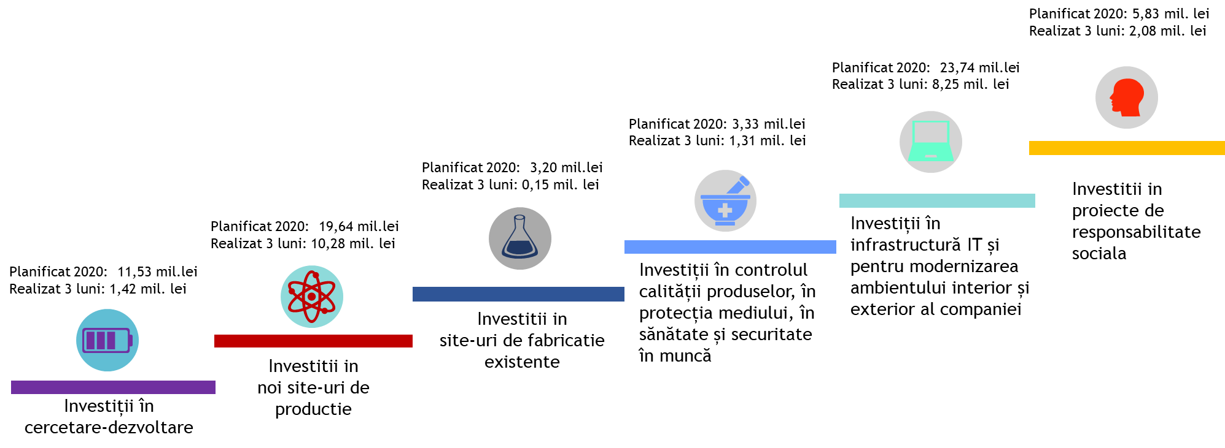
Investment breakdown
Simbol ATB
www.antibiotice.ro

Slide 18
Measures Against the COVID-19 outbreak
Scenario 1
To reduce the indirectly productive activities by working from home.
ATB
CRISIS TEAM
SCENARIO 1
Scenario 3
– forced in two cases (a confirmed case or if obliged by the authorities) to stop the productive and unproductive activities, securing and monitoring the manufacturing site.
SCENARIO 3
SCENARIO 2
Scenario 2
To completely interrupt the indirectly productive activities and limit the production ones.
ATB symbol
www.antibiotice.ro

Slide 19
The first measures taken to protect the health of our employees:
installation of disinfectant dispensers and disinfectant rubber mats at each workplace and at all the main entrances;
providing employees with the necessary sanitary and protective materials on a daily basis: masks, gloves, hand and surface disinfectants, etc.;
performing daily medical examinations by our own medical staff (3 doctors and 5 nurses) and isolating at home the employees with respiratory diseases;
periodic disinfection of traffic contact surfaces (doors, handles, taps, railings, etc.) and company buses;
cancellation of domestic events and business trips in the country and abroad;
limiting to the maximum the access of visitors in the company;
rigorous monitoring of freight transport coming from the country and from abroad, access being allowed only after disinfection of the vehicle and after checking the clinical condition of drivers according to established procedures;
constant information of employees (email, social media, displayed at workplaces / in buses) on the increase of hygiene measures and the daily situation on the platform;
introducing work at home for employees who were able to do so;
daily disinfection of employee transport buses and common areas, by nebulization;
medical examinations among employees, imposing distances at the entrance to the factory and at workplaces (1.5 - 2 meters);
wearing a mask and gloves, from the moment of boarding the transport buses and later at work, have became mandatory.
Isolation Center a+ for our own employees and collaborators
The Isolation Center a+ has 4 rooms with 8 beds, it is properly equipped (with disinfectants and cleaning materials, first-line medicines to treat respiratory diseases, personal protective equipment, as well as hygiene materials). The light forms of the current disease can be treated here.
ATB symbol
www.antibiotice.ro

Slide 20
Conclusions
Antibiotice in the first quarter of 2020:
Sales revenue increased by 13% compared to the value recorded in the same period of the previous year;
Operating profit up 6%, compared to the value recorded in the same period of the previous year;
Our company supports the public health system by adapting the product portfolio and manufacturing programs, as well as by ensuring the continuity of deliveries;
Our company has been protecting the health and safety of employees at work by implementing measures to prevent the spread of SARS-CoV-2 virus.

Slide 21


Thank you!
2020

