Slide 1
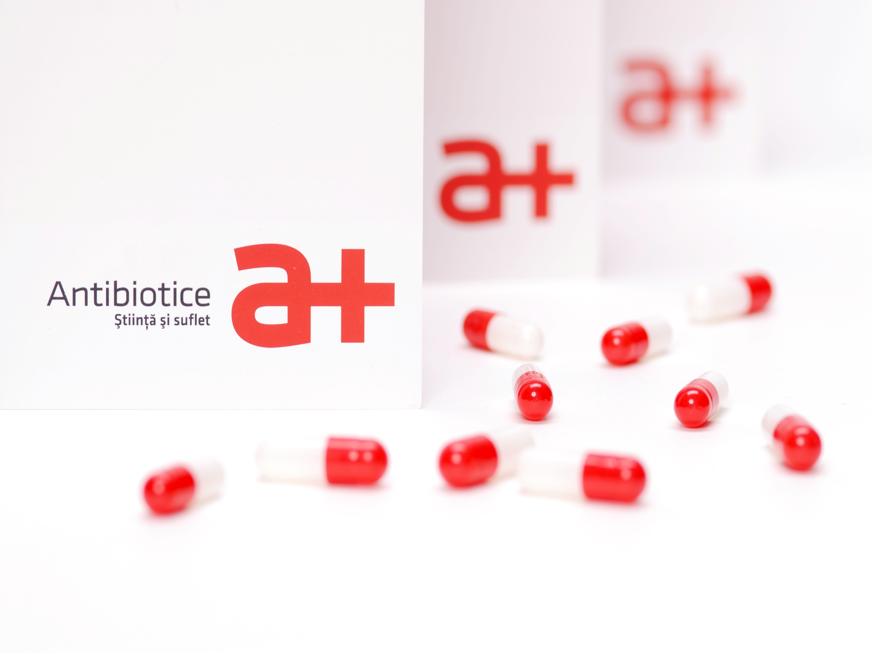
Prezentare companie

Slide 2
Tradition means continuity and recognition
  1955
Only a decade after the synthesis of Penicillin, Antibiotice began its activity and became the first producer of this active substance in Romania and in South-East Europe.
1995-1990
The manufacturing structure has developed, especially for active substances, sterile powders for injection, ointments and suppositories.
1990-1999
Antibiotice has redefined its manufacturing structure and has invested in the domestic and international marketing.
Antibiotice has been listed on the Bucharest Stock Exchange - category I since 1997.
2000-2010
Our company has invested heavily (EUR 60 million) in the modernization of technologies, in modern, competitive equipment and in the certification of quality systems to meet the GMP and US FDA standards;
Antibiotice has obtained the Food and Drug Administration (FDA) approval for the manufacturing line of Nystatin and for the manufacture of sterile injectable powders, which has allowed the export of the first injectable drugs and Nystatin to the U.S. market;
Our company has launched a new brand identity (a new logo - "a+" and a new slogan - "science and soul") that have been communicating the modernization and structural changes of the organization.
2010-2015
The company has opened its own Center for Drug Evaluation (CEM);
Antibiotice has become the first European company prequalified by WHO for anti-tuberculosis products.
USP reference standard for Nystatin.
Present day
World leader in the production of Nystatin. Strong orientation towards business internationalization and new partnerships.
Our company has business representative offices in: Vietnam, Republic of Moldova, Ukraine and Serbia.
The manufacturing activity is performed on 8 GMP and FDA authorized manufacturing lines;
The product portfolio contains 150 drugs from 12 therapeutic classes.

Slide 3
Antibiotice SA on the capital market
Investors
REMARK: (*) - Significant shareholders, according to Law no. 24/2017, Art. 2, Paragraph 2

Slide 4
Antibiotice SA in the pharmaceutical market in Romania
During the first semester of 2019 the value of the company's sales was RON 167 million (15.9% of the relevant market), experiencing an increase by +1% compared to the similar period of 2018;
The prescription products (RX) account for 80.8% of the total sales value (RON 135 million). During the same period, products without a prescription (OTC) account for 19.2% of the total (RON 32.1 million), experiencing an increase of +3.8% compared to last year.
Antibiotice SA ranks: 1st place on the relevant market (15.9% market share), 5th place on the generic and OTC segment (4.6% market share) and 19th place on the total pharmaceutical market (1.84% market share).
During the first semester of this year, Antibiotice SA has maintained its leading position in the segment of generic and OTC medicines marketed in hospitals, with a market share of 15.7%.
Antibiotice SA ranks 16th out of 221 companies in the top of non-prescription medicines and food supplements (OTC).

Slide 5
A partner of the health system in Romania
Our company is present in all over the 500 hospitals and in over 4000 pharmacies in Romania;
37 of medicinal products considered essential by the WHO for the treatment of patients are manufactured in the city of Iasi;
Our company permanently provides a safety stock in the distributor’s warehouses;
Our company supports health programs – it is the main supplier of products within the national program for the treatment of patients with tuberculosis.
Our company provides access to treatment for most medical and surgical specialties:
Infectious diseases;
Intensive care;
Cardiovascular diseases;
Dermatological and rheumatic disorders;
Digestive tract disorders;
Disorders of the central nervous system.

Slide 6
The production of Antibiotice
During the first semester of 2019 Antibiotice has manufactured:
320 million pharmaceutical units in the form of tablets, capsules, parenteral products, topical products (ointments, creams, gels), suppositories and pessaries;
During the first semester of 2019 the value of the production manufactured for export (Nystatin and finished products) has accounted for 28.6% of the total value of the products manufactured on the platform;
The total value of the production amounted to RON 228.4 million.
During the first half of 2019, starting with February, through the measures and investments implemented we achieved the compliance with the serialization process of prescription drugs in accordance with the EU Directive 62/2011, which made it possible to continue the sales of products on the European and U.S. markets.

Slide 7
Research & Development
In 2019 the research product pipeline includes a number of 15 projects, of which: 1 injectable product, 4 projects of topical forms and 10 projects of solid oral forms. These projects cover the therapeutic classes that define the portfolio of Antibiotice: oral anti-infective drugs, injectable anti-infective drugs, dermatological drugs, non-steroidal anti-inflammatory cardiovascular drugs, digestive system drugs and drugs for women's health. During the first half of 2019 these products were in different stages of development.
During the first semester of 2019, concurrently with these new research projects, activities have been carried out to optimize the products from the company's portfolio, in order to internationalize them, as follows: 5 injectable products, 2 topical products and 4 oral solid forms products.
During the first half of 2019, 2 new products in 3 concentrations were added to the portfolio of anti-infective drugs, which is representative for the company both nationally and internationally. A new dietary supplement was also notified.
For the international market, 3 new Marketing Authorizations for Antibiotice brand medicines for 2 countries from the CIS and Europe areas have been obtained.

Slide 8
The export increased by 6.34% compared to the export made during the similar period of 2018
TYPE OF PRODUCT | SEM I 2018 | SEM I 2019 | Variation %
NYSTATIN | 36,129,359 | 38,715,323 | 7.16%
FINISHED PRODUCTS | 31,852,655 | 33,575,462 | 5.41%
TOTAL (LEI) | 67,982,014 | 72,290,784 | 6.34%
The main development directions of Antibiotice SA strategy on international markets:
Developing the presence in the territories in which Antibiotice has an open representative office: Vietnam, Ukraine, Moldova and Serbia;
Increasing the market share on regulated markets, especially on the U.S. market;
Developing/consolidating the company's presence on current markets and adapting the product portfolio to potential external markets according to the local consumption specificity;
Developing new business models and partnerships on foreign markets, which will accelerate the development of the company internationally;
Maintaining the position of world leader for the production of Nystatin active substance;
The main destinations for the Antibiotice products (Finished Products and Nystatin) during the first half of 2019 were: Asia (35%), North America (20%) and Europe (15%). The sales in these areas accounted for about 70% of the sales made on foreign markets.
Export - 35% din cifra de afaceri

Slide 9
Together we create value
THE STRUCTURE OF THE STAFF ON 30.06.2019
Total employees
1415
608 higher education employees 43%
807 secondary education employees 57%

Slide 10
We are responsible for people, community and environment
We manufacture medicinal products with science, but at the same time we put our soul into what we do to always stay close to people. Antibiotice assumes the responsibility to contribute as a "good citizen" to the life of the community and it is directly involved in the development of a better society and for a cleaner environment
Corporate Social Responsibility projects
HEALTH
"The Antibiotics of the Third Millennium“
"Donate blood! Put your soul to life!"
EDUCATION
The "Science and soul" scholarships
We invest in excellence - we support national and international Olympic students – in partnership with the General School Inspectorate
SOCIAL
"The power of deed is in our power" - carried out by the Antibiotice "Science and Soul" Foundation
ENVIRONMENT
Antibiotice has been supporting the "Earth Hour" for 11 years
The school orchard

Slide 11
The situation of the overall result
During the first semester of 2019, compared to the similar period of the previous year and following the strategic objectives with focus on the internationalization of the business, the sales revenues experienced an increase of 9%, due mainly to the increase of sales on the international market.
 | Exercitiul financiar |  | 30.06.2019/30.06.2018
 | 30.06.2018 | 30.06.2019
A | 1 | 2 | 3=2/1
Sales revenues | 157.700.486 | 172.391.095 | 1,09
Other operating revenues | 14.810.614 | 18.686.567 | 1,26
Revenues relative to costs of product stocks | 23.440.792 | 26.243.033 | 1,12
Capitalized income generated by the entity's activity | 1.549.525 | 2.568.485 | 1,66
Expenses with raw materials and consumables | 73.332.578 | 78.018.365 | 1,06
Staff-related expenses | 41.996.215 | 46.888.473 | 1,12
Expenditure on amortization and depreciation | 9.800.119 | 10.329.494 | 1,05
Other operating expenses | 50.067.426 | 57.508.252 | 1,15
Operating profit | 22.305.079 | 27.144.596 | 1,22
Net financial income | -1.460.910 | -2.220.989 | 1,52
Pre-Tax Profit | 20.844.169 | 24.923.607 | 1,20
Expenses with tax on profit and other taxes | 741.122 | 2.604.531 | 3,51
Profit | 20.103.047 | 22.319.076 | 1,11
Operating profit 27.144.596 lei higher by 22%;
Pre-Tax Profit 24.923.607 lei higher by 20%;
Profit 22.319.076 lei higher by 11%.

Slide 12
Statement of financial position
 | Financial period |  | 30.06.2019/31.12.2018
 | 31.12.2018 | 30.06.2019
0 | 1 | 2 | 3=2/1
ASSETS
FIXED ASSETS
Tangible fixed assets | 310.640.665 | 316.959.046 | 1,02
Intangible fixed assets | 15.028.716 | 16.134.982 | 1,07
TOTAL FIXED ASSETS | 325.669.381 | 333.094.028 | 1,02
CURRENT ASSETS
Stocks | 64.964.662 | 97.450.800 | 1,50
Trade and similar receivables | 313.094.458 | 307.600.266 | 0,98
Cash and cash equivalents | 2.376.682 | 3.612.663 | 1,52
TOTAL CURRENT ASSETS | 380.435.802 | 408.663.729 | 1,07
TOTAL ASSETS | 706.105.183 | 741.757.757 | 1,05
LIABILITIES
CURRENT LIABILITIES
Trade and similar liabilities | 67.171.084 | 76.126.997 | 1,13
Amounts due to credit institutions | 100.729.229 | 104.527.433 | 1,04
Tax and current tax liabilities | 10.421.393 | 11.528.226 | 1,11
Subsidies for investments | 637.008 | 0
TOTAL CURRENT LIABILITIES | 178.958.714 | 192.182.657 | 1,07
LONG-TERM LIABILITIES
Subsidies for investments | 2.489.791 | 3.192.430 | 1,28
Deferred tax | 25.266.930 | 25.498.134 | 1,01
Amounts due to credit institutions | 26.662.433 | 32.545.823 | 1,22

Slide 13
 | Financial period |  | 30.06.2019/31.12.2018
 | 31.12.2018 | 30.06.2019
0 | 1 | 2 | 3=2/1
TOTAL LONG-TERM LIABILITIES | 54.419.154 | 61.236.387 | 1,13
TOTAL LIABILITIES | 233.377.868 | 253.419.044 | 1,09
Share capital and reserves
Share capital | 264.835.156 | 264.835.156 | 1,00
Revaluation reserves | 53.459.597 | 52.110.023 | 0,97
Legal reserves | 13.426.761 | 13.426.761 | 1,00
Other reserves | 190.422.002 | 193.386.084 | 1,02
Retained earnings | -60.182.699 | -57.738.387 | 0,96
Distribution of profit | -23.537.290 | 0 | 0,00
Current profit | 34.303.788 | 22.319.076 | 0,65
TOTAL EQUITY | 472.727.315 | 488.338.713 | 1,03
TOTAL EQUITY & LIABILITIES | 706.105.183 | 741.757.757 | 1,05

Slide 14
Operational indicators
Indicators | Calculation method | Unit of measure | 30.06.2018 | 30.06.2019
Indicators | Calculation method | Unit of measure | 30.06.2018 | 30.06.2019
Current liquidity | Current assets /Current liabilities | number of times | 2.04 | 2.11
Level of indebtedness | Borrowed capital / Equity * 100 | % | 28.94 | 28.07
Turnover speed for client debit items | Average customer balance / Sales revenue * Time | days | 322 | 303
Fixed assets turnover speed | Sales revenue / Fixed assets | number of rotations | 0.65 | 0.52
Return on equity (ROE) | Net profit/Equity | % | 4.25 | 4.57
Return on assets (ROA) | Net profit /Total assets | % | 2.85 | 3.01
Earnings per share (EPS) | Net profit/shares | LEI/share | 0.030 | 0.031
Net profit rate | Net profit/Sales revenue | % | 12.75 | 12.95
Number of share | Subscribed and paid capital/Number of shares | shares | 671,338,040 | 671,338,040

Slide 15


Thank You!
Q & A
2015

