Slide 1
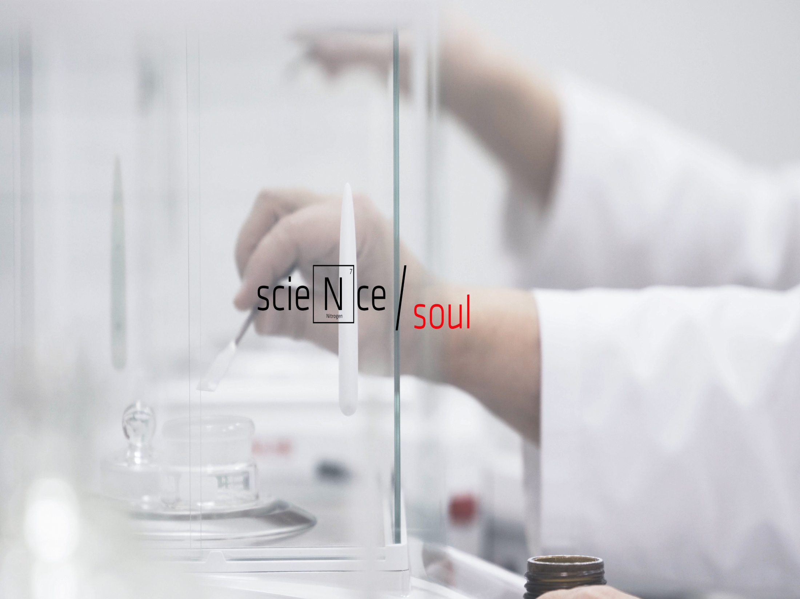
PERFORMANCE THROUGH INTERNATIONAL STANDARD QUALITY

Slide 2
Tradition means continuity and recognition
2006 Antibiotice establishes its own Center for Drug Evaluation(CEM), which conducts Phase I clinical trials and bioequivalence studies. CEM is Good Laboratory Practice (GLP) certified and authorized by the Ministry of Health.
The Quality Management System implemented by Antibiotice is ISO 9001:2000 certified by Lloyd's Register Quality Assurance (LRQA).
2007 Antibiotice SA obtains the recognition for implementing the Integrated Management System for quality, environment, health and safety at work according to the EN ISO 9001:2008, EN ISO 14001:2004 and OHSAS 18001:2007 standards.
2010 Antibiotice delivers the first finished products in the USA, the market in which our company traded until 2010 only active substances.
2011 The manufacturing flow of penicillins, injectable sterile powders obtains the FDA authorization, which allows expanding the export of these products in the US market.
Antibiotice launches its first products from the Central Nervous System (CNS) class.
2012 Antibiotice becomes the first European company prequalified by the World Health Organization for the range of anti-tuberculosis drugs.

Slide 3
Tradition means continuity and recognition
2013
- Antibiotice is FDA recertified, its manufacturing flows of sterile injectable powders and active substance Nystatin being also GMP and NAMMD recertified;
- Antibiotice becomes the world leader manufacturer of active substance Nystatin.
2015
- U.S.FDA authorization for Nystatin and injectable products;
- Certificate of Suitability with the European Pharmacopoeia (COS) for Nystatin;
Good Manufacturing Practice(GMP) Certificate for all the manufacturing flows, Integrated Management System.
2016
Antibiotice establishes its representative office in Vietnam;
Antibiotice obtains 25 new marketing authorizations, in 6 countries in Europe, Asia and Africa and initiated 2 decentralized European procedures for simultaneous authorization in EU countries.
2017 – Present
- World leader in the production of Nystatin, the active substance which is a USP international reference standard;
- Antibiotice launches its first Non-financial Report for 2017, a document representing a transparency approach in accordance with the national legislation and with the requirements on international sustainability –Global Reporting Initiative Standards.

Slide 4
Mision, Vision, Values
Mision | We make our valuable medicines more accessible to patients and health professionals. We constantly seek new ways to contribute to a better health and life for people.
Vision | We are honest, compassionate and constantly concerned about the modernization of our business and products. We believe a valuable medicine is an effective and safe one that people can afford and which brings us a reasonable profit. A profit that satisfies our shareholders and allows us to target performance, permanently investing in people, technology and carefully selected partnerships.
Values | We value the efficiency, knowledge and spirit of cooperation that allow us to be oriented towards the changing needs of our customers and end-users. We mutually recognize our purpose and value, which connect one another and give us the chance to overcome the limits and obstacles. As people, we care about those around us, we seek to be close to them and we always think about how to improve things that are important to them.

Slide 5
Shareholding structure
April 1997: Antibiotice is listed in the Premium category of the Bucharest Stock Exchange;
2005: ATB shares included in the ROTX index of the Vienna Stock Exchange;
2007: ATB shares included in the Dow Jones Wilshire Global Total Market index of the New York Stock Exchange and in the Bucharest Exchange Trading (BET) index;
In the Q12019, a number of 1.651.338 shares, with a total value of 170.105 EUR were traded.
Over 708 million of shares, with a total value of more than 115 million EUR were traded in those more than 21 years of listing.

Slide 6
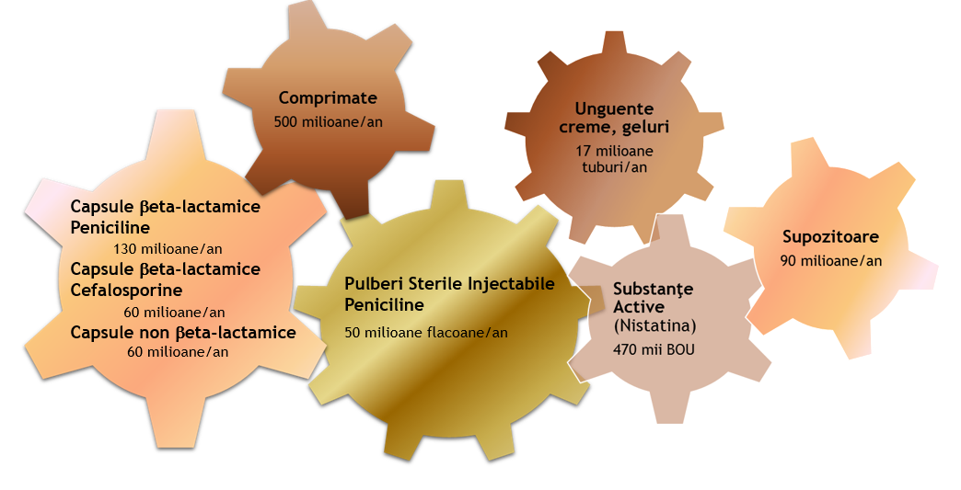
Production breakdownfabricae Structură complexă de fabricație ă complexă de fabricație

Slide 7
Domestic market
We are present in all over 500 hospitals and more than 4000 pharmacies in Romania;
37 of the medicines considered essential by WHO for the treatment of patients are manufactured in Iași;
The most important manufacturer of generic medicines with Romanian capital - 10% market share;
Portfolio of over 150 products in the following therapeutic areas – antiinfectives, cardiovasculars, dermatologicals, medicines for digestive tract, central nervous system, genito-urinary tract;
Leader in the production of injectable beta-lactam antibiotics in Romania - 95% market share;
Leader in the topical product segment(creams. ointments. gels) - 30% market share;

Slide 8
Domestic market
Sales revenue in the domestic market rose from 29.3 million LEI in Q1 2018 to 34.9 million LEI in QI 2019. Structurally, the positive evolution was influenced by:
Our company's top products with traditional high sales during this period (injectables for hospitals : amoxicillin with clavulanic acid, colistin, meropenem, imipenem with cilastatin; products for oral use: cefixime, amoxicillin, glycerin range);
Performance of some relatively recently introduced products in our portfolio (memantine range, range of food supplements – Silithor (hepatoprotective product), Fluxiv (venous circulation.
* Our marketing & sales policy in the domestic market has been oriented towards a profitable sales structure, towards optimizing the potential of the products in the relevant market (the market of the molecules existent in our portfolio ) as well as towards optimizing the stock level from our partners in the market – distributors and pharmacies.
(million LEI)
Name of indicator* | 31.03.2018 | 31.03.2019 | ∆ 01 - 03 2019/2018
Net sales (domestic market) | 29.28 | 34.90 | 19.2%
Sell IN distribution | 76.36 | 82.43 | 8.0%
Sell OUT distribution (Pharmacies+Hospitals) | 82.90 | 85.44 | 3.1%

Slide 9
Comprehensive income statement (LEI) | 31.03.2018 | 31.03.2019 | 2019/2018
1 | 2 | 3 | 4=3/2
Sales income | 59.220.466 | 65.066.014 | 1.10
Other operating income | 10.234.373 | 8.952.087 | 0.87
Income related to product stock costs | 14.149.596 | 16.661.315 | 1.18
Income from the work performed by entity and capitalized | 765.128 | 1.035.011 | 1.35
Expenditure on raw materials and consumables | 31.624.850 | 33.120.317 | 1.05
Staff costs | 20.535.077 | 23.718.951 | 1.16
Amortization and depreciation expense | 4.847.956 | 5.159.090 | 1.06
Other operating expense | 23.530.703 | 24.549.531 | 1.04
Operating profit | 3.830.977 | 5.166.539 | 1.35
Financing costs | -571.013 | -1.032.744 | 1.81
Pre-tax profit | 3.259.964 | 4.133.795 | 1.27
Expenses on current and deferred income tax | 0 | 864.384
Profit | 3.259.964 | 3.269.411 | 1.00

Slide 10
By synthesizing the financial statements, we present the effects of our activities reflected in the following indicators:
Name of indicator | Calculation formula | 31.03.2018 | 31.03.2019
Current liquidity | Current assets/Current liabilities | 2.22 | 2.14
Level of indebtedness | Borrowed capital/Equity x 100 | 20.03% | 27.81%
Turnover speed for client debit items | Average Customer Balance / Sales Income x Time | 370 days | 371 days
Turnover speed of fixed assets | Sales Income / Fixed Assets | 0.25 | 0.20
Since, at the date of the current report, the claw-back tax is at the estimated value, the final calculations have not yet been communicated by the National House of Social Health Insurance. The value of the profit in Q2 2019 will be influenced by the actual level of the clawback tax.

Slide 11
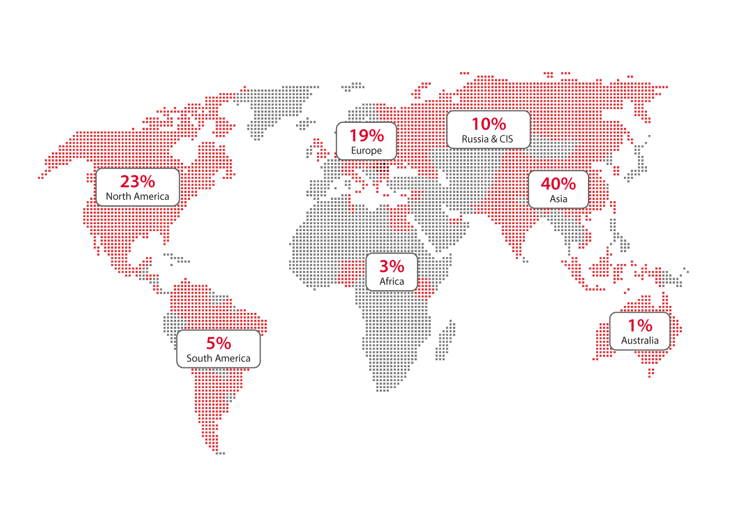
International market
Export - 35% of turnover
Export in 70 countries
Internationally recognized quality
Export in 70 countries
Antibiotice reached its planned sales target for Q1 2019 in the international market, in value of about 30 million LEI. The main targeted markets are in Asia, North America and Europe, our sales in these areas representing about 70% of the export sales revenue in Q I 2019. Antibiotea its planned sales target for Q I 2019 in the international market worth about 30 million LEI. The main targeted markets are in Asia, North America and Europe, our sales in these areas representing approximately 70% of export sales revenue in Q1 2019.
Representative offices in Vietnam, Republic of Moldova, Ukraine and the agency from Serbia.
World leader in the production of Nystatin – active substance - over 50% market share globally (over 100% increase in 10 years).

Slide 12
Strategic Planning
Pillar 1
Business internationalization.
Pillar 2
Adapting strategically our portfolio. Ensuring a sustainable and marketable portfolio.
Pillar 3
Management of operating costs and an increased yield of the operating, financing and investing activities;
Pillar 4
Adapting human resources to the strategic orientation and focus of organizational culture towards innovation and performance and promoting social responsibility programs.
Pillar 5
Quality management.

Slide 13
Strategic planning
Investment plan for the period 2019 – 2021 amounts to 172.4 million LEI, which determines a cumulative amortization value of 92.4 million LEI in this period, generating a gross profit of 27 million LEI in 2021, an operating profit rate of 8% and a level of indebtedness of 38%.
Sales revenue
(million LEI)
365 in 2018
450 in 2021
Share of new products in turnover
7.60% in 2018
5% in 2021
Antibiotice
Strategic objectives
Gross profit
(million LEI) 35 in 2018
27 in 2021
Operating profit rate 11% in 2018
8% in 2021
Domestic market share
2.11% in 2018
2.27% in 2021
Export (million LEI) 124 in 2018
166.5 in 2021
World leader
Nystatin
Max level of
indebtedness
in turnover
33% in 2018
38% in 2021

Slide 14
Planificare Strategica
Strategic planning

Slide 15
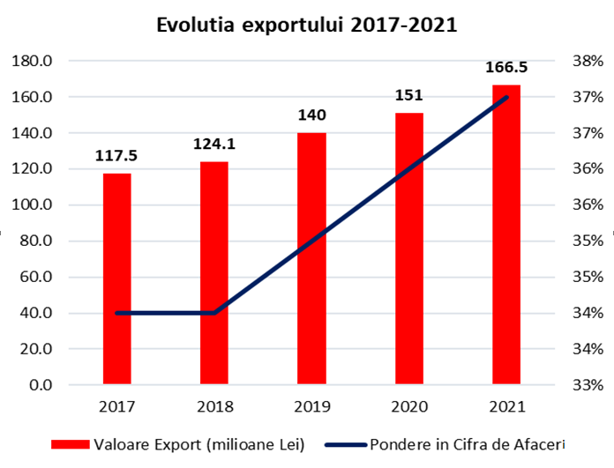
Strategic planning

Slide 16
Business Development
Considering the dynamics of the global pharmaceutical industry, the role of Business Development is to ensure a lasting and sustainable improvement of existing activities and identify and develop new business opportunities;
Business development projects target complex medium and long-term strategic partnerships in areas such as new product development, attraction of new products in the company portfolio through licensing agreements and an extension of our presence in foreign markets through licensing the products in Antibiotice portfolio;
Business Development activity has a direct impact on increasing the company’s turnover, profitability and providing an optimal portfolio of products to ensure the company's competitiveness on medium and long term;
Allows access to highly developed markets such as U.S.A. and Western Europe, requiring partnerships with local businesses for registration, marketing, promotion and sales activities;

Slide 17
Research-Development
Antibiotice develops its medicine portfolio by in-house research, from pharmaceutical formulation to a confirmed efficacy and safety of the product through bioequivalence studies and clinical trials;
More than 100 specialists with relevant expertise in pharmaceutical formulation, complex analytical tests, bioequivalence, international regulations on pharmaceutical products are involved in pharmaceutical research & development.
Antibiotice has one of the most modern Centers for Clinical Studies in Romania.
It was established in 2005, the investment rising to over 10 million EUR. Currently, the capacity of the Center, which is Good Clinical Practice and Good Laboratory Practice authorized, is 10-12 bioequivalence studies per year.
Farmacovigilance system connected to Eudravigilance.

Slide 18
Investments
Compliance with the requirements of the European Directive and Law on the Quality and Safety of Medicines (USA) and fighting counterfeit medicines 5 million EUR
A new production facility for ointments and suppositories
20 million EUR
Upgrading and expanding the Biosynthesis Plant which produces the active substance Nystatin and diversifying the products
10 million EUR
A new production plant for sterile solutions and a new Research & Development Center
30 million EUR

Slide 19
Relevant events
Antibiotice company, in the current pharmaceutical market context in Romania*:
leader in the relevant market by volume of sales (8 million boxes, 12.2% of the relevant market);
ranked second in the relevant market by value of sales (85.4 million LEI, 8.84% of the relevant market);
ranked second in the relevant market, with a value market share of 8.84% (from a number of 153 competitors);
ranked third in the relevant market, by number of indivisible units sold (112.6 million I. U., 7.4% of the relevant market);
leader in the market, by number of ointments sold (25% of the total market, 34.3% of the relevant market);
leader in the market, by number of suppositories sold (42.3% of the total market, 46% of the relevant market);
leader in the market, by number of sold vials with injectable powders (68.5% of the total market, 90% of the relevant market).
Data source – pharma market research firm, Cegedim Romania

Slide 20
Thank you!

