Slide 1
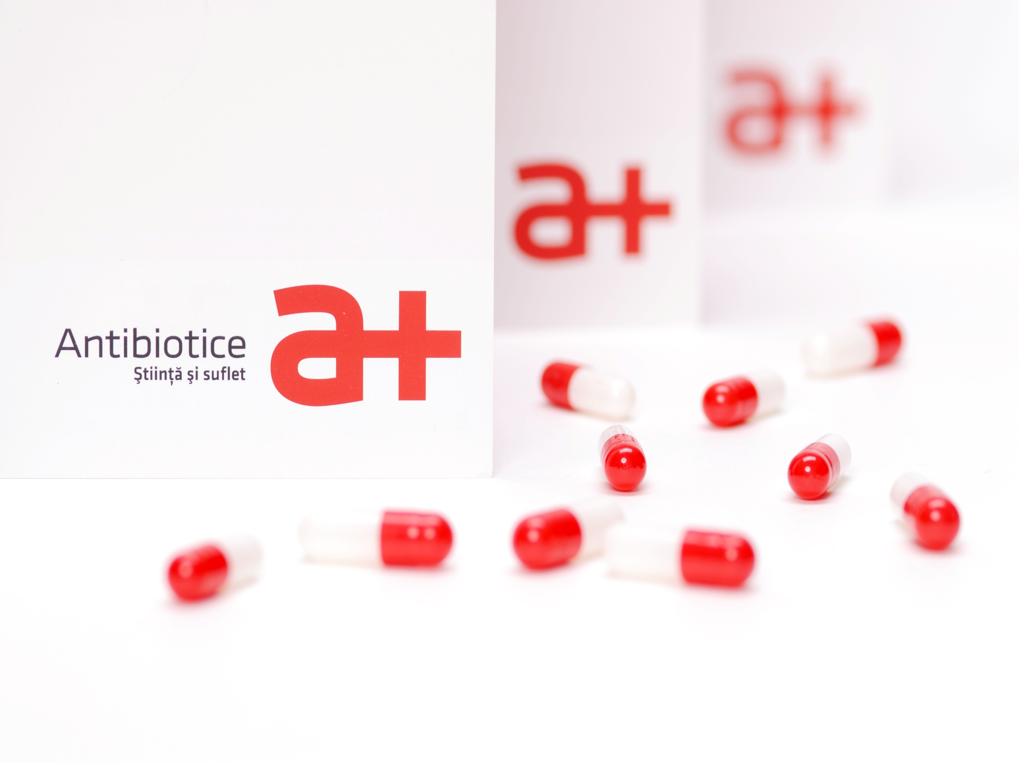
Prezentare companie

Slide 2
Shareholding structure – 20.02.2018

Slide 3
Antibiotice in the first quarter of 2018
strengthening its position on the antiinfectives and dermatologicals segment through which the company ranks first in the prescription and over-the-counter medicine market;
increases above the market growth rate in therapeutic areas of interest and valuable for the Romanian health system:
cardiovascular system: +44% increase in the portfolio value compared to the QI 2017 in the context in which the market of this therapeutic class grew by 10.7%,
central nervous system: +22% increase in terms of value compared to the
QI 2017 while the market of this therapeutic class grew by 5.7%.

Slide 4
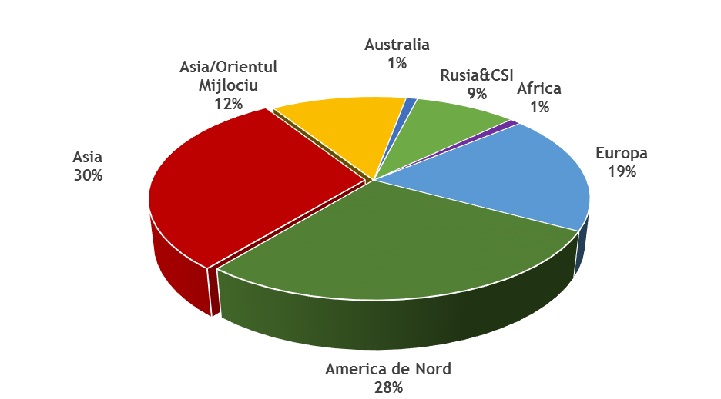
Antibiotice, a highly dynamic company in the foreign market
about 11% increase in sales compared to the same period of 2017;
sales of Nystatin tripled in the USA market
Asia: 30 %
Asia/ Middle East: 12%
Australia: 1 %
Russia & CIS: 9%
Africa: 1%
Europe: 19%
North America: 28%

Slide 5
Profit eroded by a 10-million LEI claw back tax
Statement of comprehensive income(LEI) | 31.03.2017 | BVC 2018 Q I | 31.03.2018 | 2018/2017 | 2018 /BVC
1 | 2 | 3 | 4 | 5=4/2 | 6=4/3
Sale income | 55,416,200 | 56,101,000 | 59,220,464 | 1.07 | 1.06
Other operating income | 4,290,879 | 4,779,000 | 10,234,373 | 2.39 | 2.14
Income related to product stock costs | 17,219,207 | 16,068,000 | 14,149,596 | 0.82 | 0.88
Income from the work performed by the entity and capitalised | 298,086 | 320,000 | 765,128 | 2.57 | 2.39
Costs of raw materials and consumables | 27,969,927 | 29,615,000 | 31,624,850 | 1.13 | 1.07
Staff costs | 18,063,402 | 20,377,000 | 20,535,077 | 1.14 | 1.01
Amortization & depreciation expenses | 4,590,823 | 5,100,000 | 4,847,956 | 1.06 | 0.95
Other operating expenses | 21,031,538 | 18,564,000 | 23,530,704 | 1.12 | 1.27
Operating profit | 5,568,681 | 3,612,000 | 3,830,976 | 0.69 | 1.06
Financing costs | -224,140 | -432,000 | -571,013 | 2.55 | 1.32
Pre-tax profit | 5,344,541 | 3,180,000 | 3,259,964 | 0.61 | 1.03
Profit tax expenses | 43,348 | 509,000 | 0 | 0.00 | 0.00
Profit | 5,301,193 | 2,671,000 | 3,259,964 | 0.61 | 1.22

Slide 6
Focus on performance
Name of indicator | Calculation method | 31.03.2017 | 31.03.2018
Current liquidity | Current assets/Current liabilities | 2.71 | 2.22
Degree of indebtedness | Loan capital/Equity x 100 | 14.7% | 20.03%
Turnover speed for client debit items | Average customer balance/Sales income x Time | 413 zile | 370 zile
Turnover speed of fixed assets | Sales income/Fixed assets | 0.25 | 0.25
The company's diagnostic indicators are a consequence of increasing the liquidity needs due to the increase of the claw tax together with an average 60-day extension for settling up funds from the National Health Insurance House.

Slide 7
33 new reseach & development projects in 2018
antinfectives(8 products);
cardiovasculars (5 products);
dermatologicals (7 products);
genito-urinary medicines (1 product);
respiratory tract medicine (1 product);
digestive tract medicines (2 products);
products for prophylaxis and quality of life in the category of food supplements, cosmetics and OTC medicines(10 products).

Slide 8
The most valuable resource - the highly well-trained employees
Number of employees on March 31, 2017: 1420
Training sessions were held for a number of 98 specialists within the company with the following themes:
Training for using the LIMS system (Laboratory information management system) for the staff from the Quality Control, Analytical Unit, Information Technology;
Smart Builder training for using Electronic Laboratory Notebook (ELN) for the Analytical Unit staff;
GMP training for the Quality Assurance and Quality Control staff;
Merck Chromatography Seminar for the Quality Control and Analytical Unit staff;
Pharmacokinetics and Biopharmacy applied in the pharmaceutical industry for the staff from Development-Research Department and Analytical Unit;
Training on serialization in the pharmaceutical industry, SARTOROM Pharma Track and Trace Conference for the staff from the Quality Assurance Department and Parenteral Product Plant;
Training in the field of human resources, regarding the trends in the labor market;
Legislative changes in wages and social contributions;
ANRE (National Energy Regulation Agency) trainings for the Electrical Department staff;
Training for using EPLAN electrical schematic design software;
Professional training for the specialists from the metrology laboratories;
Training on the new ISO 17025:2017 on the measurement systems analysis (MSA), for the staff from the Automation Department;
Training on Strategy and Impact of Social Responsibility Projects for the Counseling & Communication Department staff;
Warehouse Management Best Practices Training.

Slide 9



2015

